Slide 1



A Hands-On Introduction to Computational Fluid Dynamics
Mohammad Umair†, Gerardo Zampino† and Ricardo Vinuesa†
†FLOW, Engineering Mechanics, KTH Royal Institute of Technology, Sweden

Slide 2
Computational Fluid Dynamics
PURE
EXPERIMENTS
17th Century
France and England

Slide 3
Computational Fluid Dynamics
PURE
EXPERIMENTS
PURE
THEORY
17th Century
18th – 19th Century
France and England
Europe

Slide 4
Computational Fluid Dynamics
20th Century
PURE
EXPERIMENTS
PURE
THEORY
17th Century
18th – 19th Century
France and England
Europe

Slide 5
Computational Fluid Dynamics
20th Century
PURE
EXPERIMENTS
PURE
THEORY
17th Century
18th – 19th Century
France and England
Europe
CFD
A new “third approach” in the philosophical study of fluid dynamics

Slide 6
Computational Fluid Dynamics
20th Century
PURE
EXPERIMENTS
PURE
THEORY
17th Century
18th – 19th Century
France and England
Europe
CFD
A new “third approach” in the philosophical study of fluid dynamics
(Nothing more than that!)

Slide 7
Computational Fluid Dynamics
20th Century
PURE
EXPERIMENTS
PURE
THEORY
17th Century
18th – 19th Century
France and England
Europe
Just to keep things in perspective:
CFD nicely compliments the other two approaches but will never replace either of them - as sometimes suggested!
CFD
A new “third approach” in the philosophical study of fluid dynamics
(Nothing more than that!)

Slide 8
Computational Fluid Dynamics
20th Century
PURE
EXPERIMENTS
PURE
THEORY
17th Century
18th – 19th Century
France and England
Europe
Just to keep things in perspective:
CFD nicely compliments the other two approaches but will never replace either of them - as sometimes suggested!
Future advancement will rest upon a proper balance of all three approaches, with CFD helping to interpret results of theories and experiments, and vice-versa.
CFD
A new “third approach” in the philosophical study of fluid dynamics
(Nothing more than that!)

Slide 9
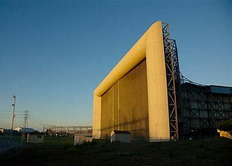
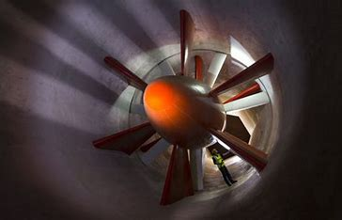
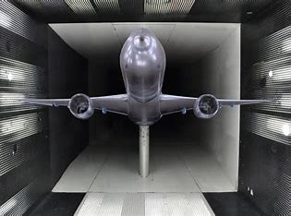
CFD as a research tool
CFD results are directly analogous to Wind Tunnel results.
However, unlike a wind tunnel a computer program can be carried everywhere or can be accessed sitting 1000 miles away!
A CFD program is, therefore, a “readily transportable wind tunnel”, where you can carry out “numerical experiments”.

Slide 10
CFD as a research tool: Who cares?

Slide 11
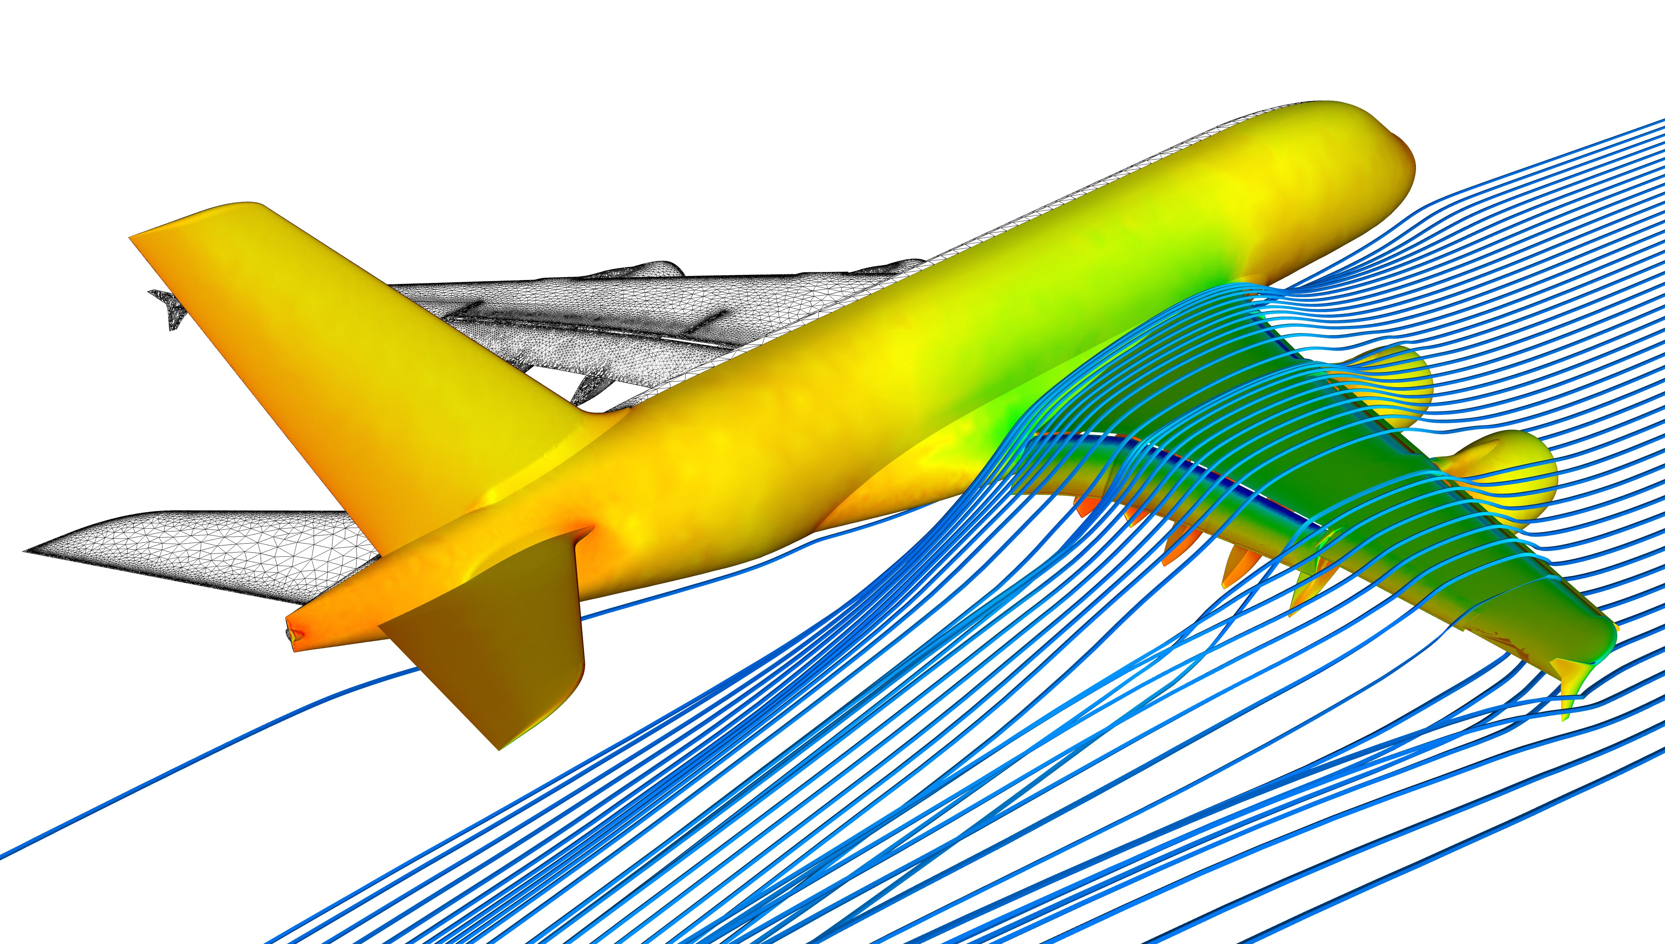
CFD as a research tool: Who cares?
Aviation

Slide 12
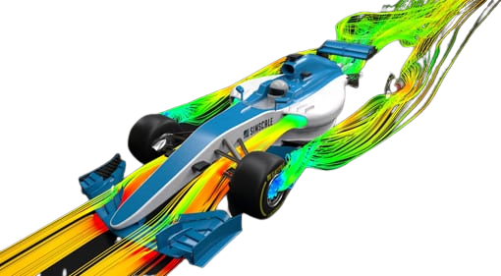
CFD as a research tool: Who cares?
Aviation
Automotive

Slide 13
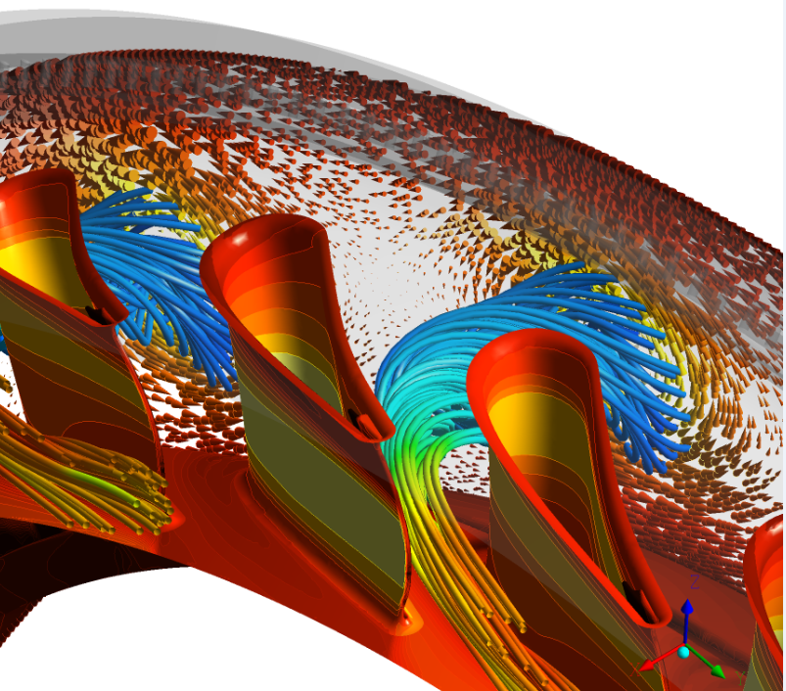
CFD as a research tool: Who cares?
Turbomachines
Aviation
Automotive

Slide 14
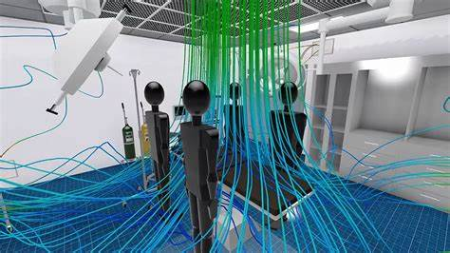
CFD as a research tool: Who cares?
HVAC
Turbomachines
Aviation
Automotive

Slide 15
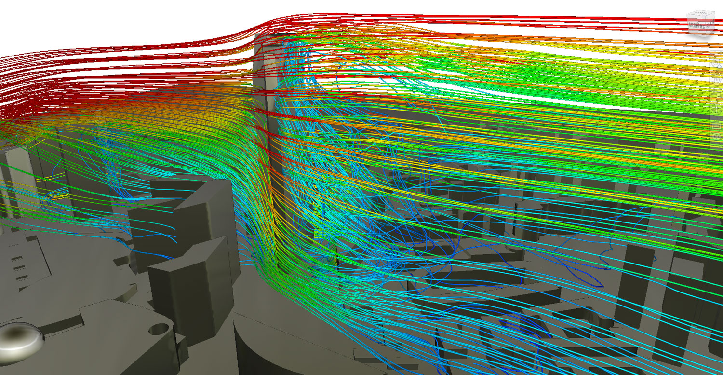
CFD as a research tool: Who cares?
Cities
HVAC
Turbomachines
Aviation
Automotive

Slide 16
CFD as a research tool: Who cares?
Cities
HVAC
Turbomachines
Aviation
Automotive
+ many more !

Slide 17
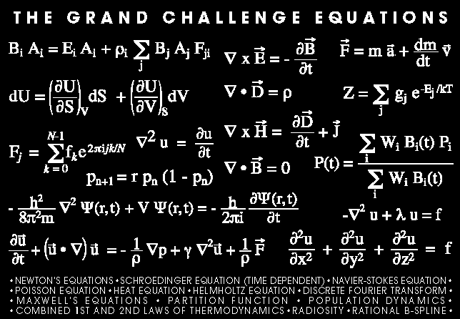
So How to CFD?
CFD involves:
Identifying the physical phenomenon, that includes Governing equations, Initial & Boundary conditions.
Breaking down the continuous problem to a discrete representation.
Solving the discrete set of equations using adequate numerical methods.
Post processing the results.

Slide 18
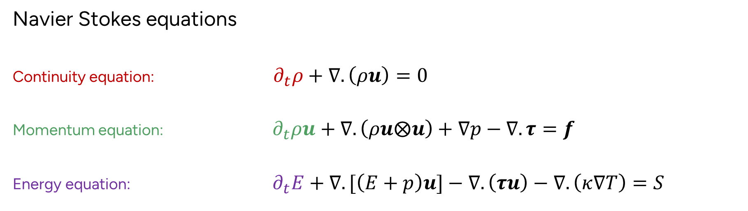
What are we solving?
Navier Stokes equations
Continuity equation: $∂_{t}ρ+∇.\left(ρu\right)=0$
Momentum equation: $∂_{t}ρu+∇.\left(ρu⨂u\right)+∇p−∇.τ=f$
Energy equation: $∂_{t}E+∇.[\left(E+p\right)u]−∇.\left(τu\right)−∇.\left(κ∇T\right)=S$
Depending on the nature of physics governing the fluid motion one or more terms might be negligible.
Presence of each term and their combinations determines the appropriate solution algorithm and the numerical procedure.

Slide 19
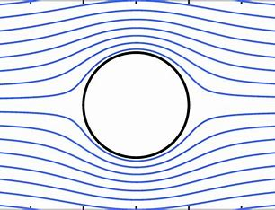
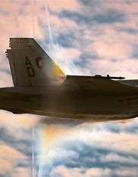
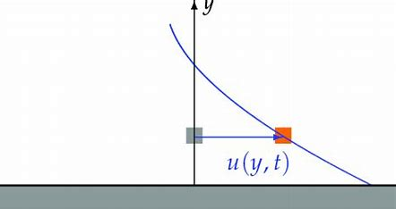
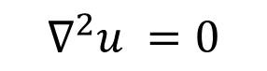
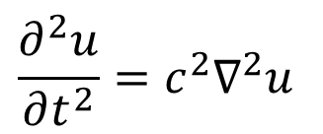
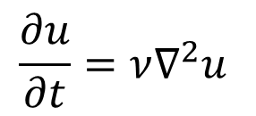
Classification of PDEs
Elliptic
Parabolic
Hyperbolic
$$\frac{∂u}{∂t}=ν∇^{2}u$$
$$\frac{∂^{2}u}{∂t^{2}}={c^{2}∇}^{2}u$$
$$∇^{2}u =0$$
Potential Flow
Flow over an oscillating plate
(Stokes 2nd Problem)
Wave motion
Equations belonging to each of these classifications behave in different ways both physically and numerically.

Slide 20
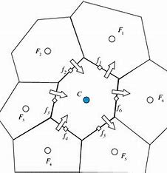
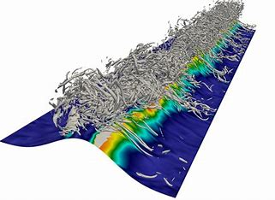
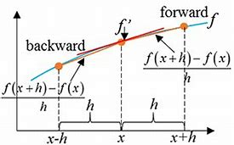
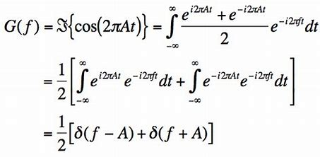
Techniques for Numerical Discretization
Discretization
Governing Equations
Numerical Analogue
Commonly used discretization methods
Finite Difference Methods
Spectral
Methods
Finite Volume Methods
Finite/Spectral Element Methods

Slide 21
Techniques for Numerical Discretization
Discretization
Governing Equations
Numerical Analogue
Commonly used discretization methods
TODAY
TOMORROW
Finite Difference Methods
Spectral
Methods
Finite Volume Methods
Finite/Spectral Element Methods

Slide 22
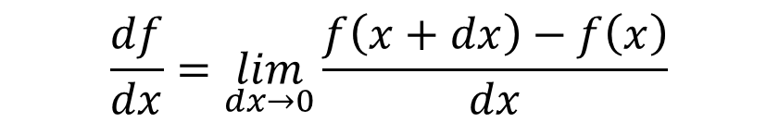
Finite Difference Method
Definition of a derivative
Exact
$$\frac{df}{dx}=\lim_{dx→0}{\frac{f\left(x+dx\right)−f\left(x\right)}{dx}}$$

Slide 23
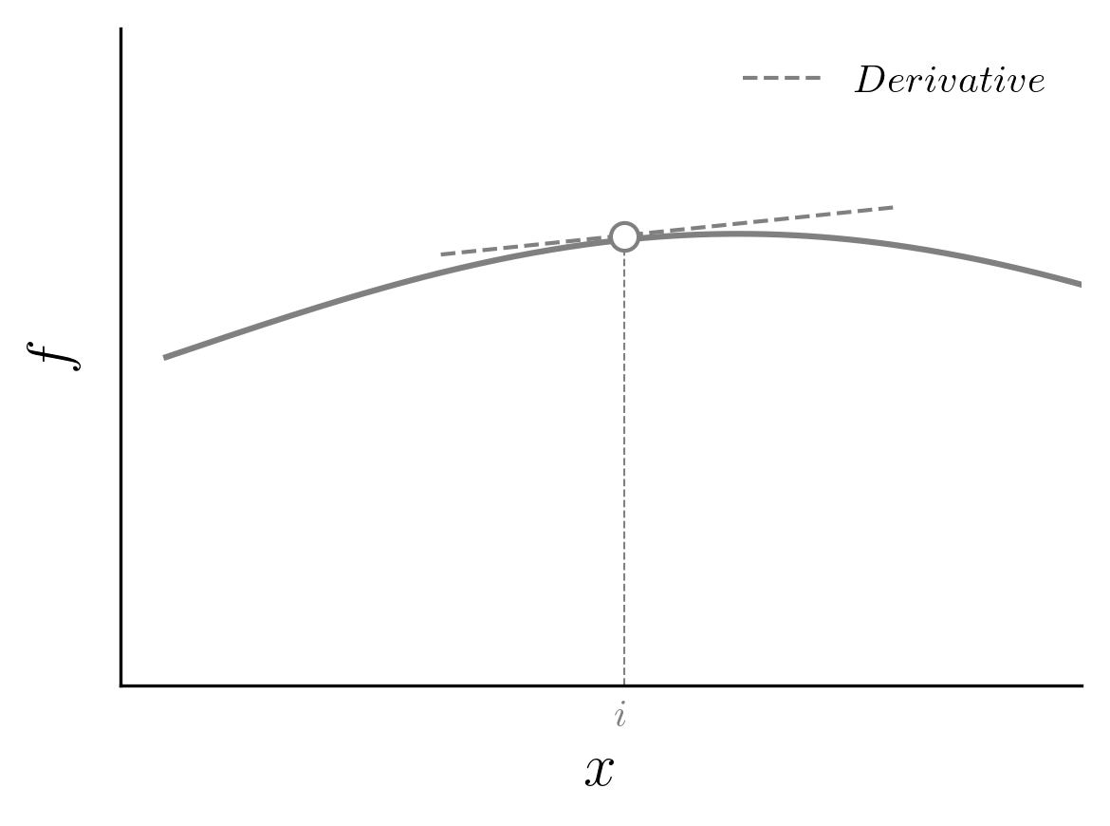
Finite Difference Method
Definition of a derivative
Exact
$$\frac{df}{dx}=\lim_{dx→0}{\frac{f\left(x+dx\right)−f\left(x\right)}{dx}}$$

Slide 24
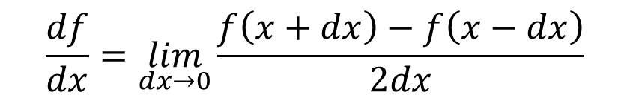
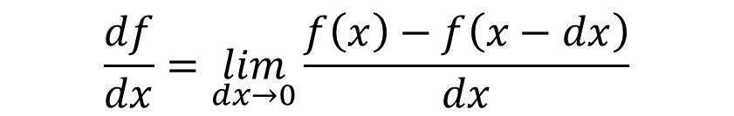
Finite Difference Method
Definition of a derivative
Exact
$$\frac{df}{dx}=\lim_{dx→0}{\frac{f\left(x+dx\right)−f\left(x\right)}{dx}}$$
$$\frac{df}{dx}=\lim_{dx→0}{\frac{f\left(x\right)−f\left(x−dx\right)}{dx}}$$
$$\frac{df}{dx}=\lim_{dx→0}{\frac{f\left(x+dx\right)−f\left(x−dx\right)}{2dx}}$$

Slide 25
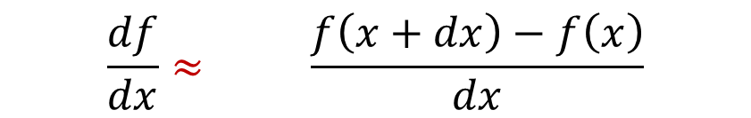
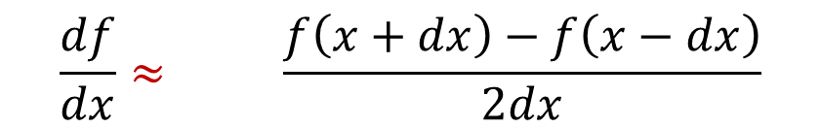
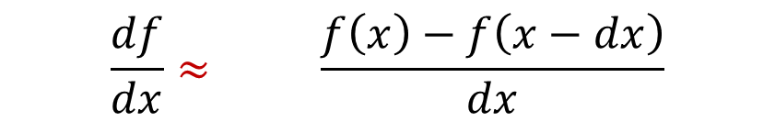
Finite Difference Method
Finite Difference
$$\frac{df}{dx}≈\lim_{dx→0}{\frac{f\left(x+dx\right)−f\left(x\right)}{dx}}$$
$$\frac{df}{dx}≈\lim_{dx→0}{\frac{f\left(x\right)−f\left(x−dx\right)}{dx}}$$
$$\frac{df}{dx}≈\lim_{dx→0}{\frac{f\left(x+dx\right)−f\left(x−dx\right)}{2dx}}$$

Slide 26
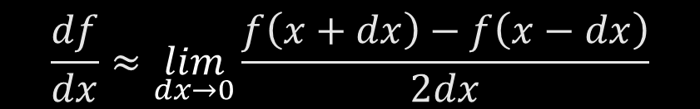

Finite Difference Method
Finite Difference
$$\frac{df}{dx}≈\lim_{dx→0}{\frac{f\left(x+dx\right)−f\left(x\right)}{dx}}$$
$$\frac{df}{dx}≈\lim_{dx→0}{\frac{f\left(x\right)−f\left(x−dx\right)}{dx}}$$
$$\frac{df}{dx}≈\lim_{dx→0}{\frac{f\left(x+dx\right)−f\left(x−dx\right)}{2dx}}$$

Slide 27
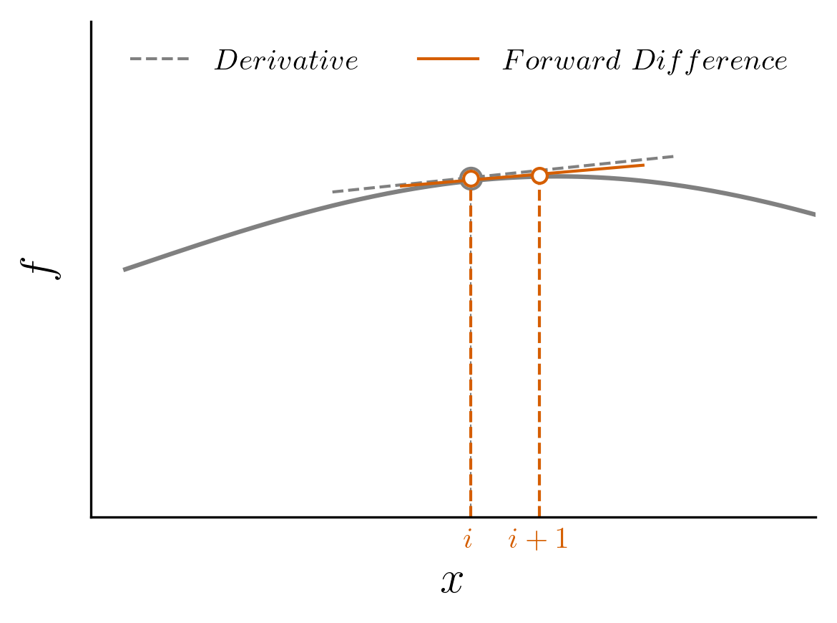

Finite Difference Method
Finite Difference
$$\frac{df}{dx}≈\frac{f\left(x+dx\right)−f\left(x\right)}{dx}$$
Forward

Slide 28
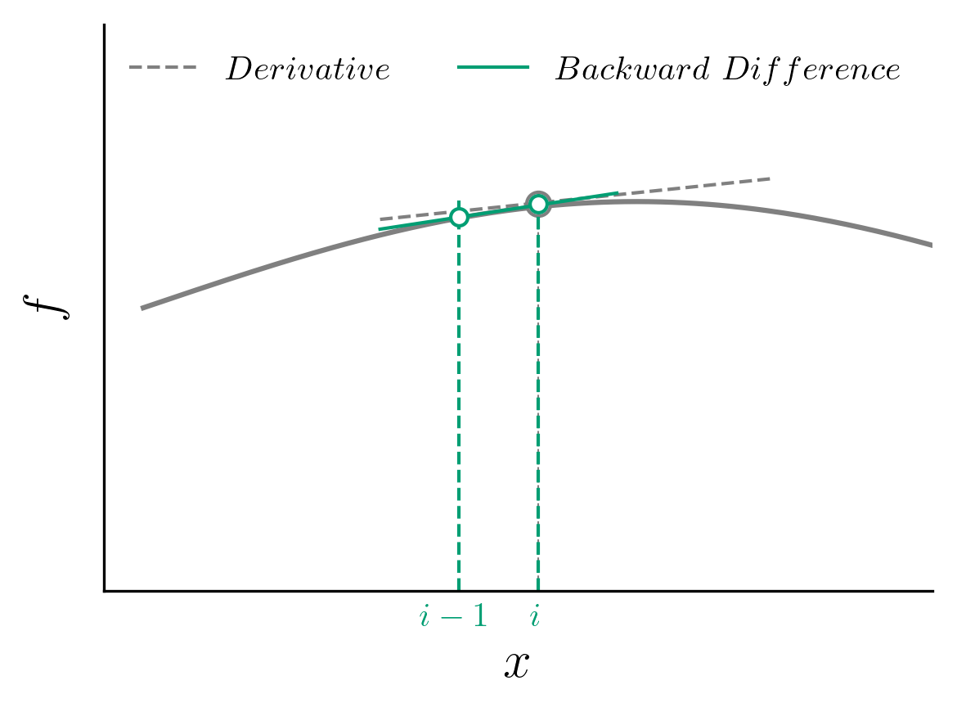

Finite Difference Method
Finite Difference
$$\frac{df}{dx}≈\frac{f\left(x+dx\right)−f\left(x\right)}{dx}$$
Forward
$$\frac{df}{dx}≈\frac{f\left(x\right)−f\left(x−dx\right)}{dx}$$
Backward

Slide 29
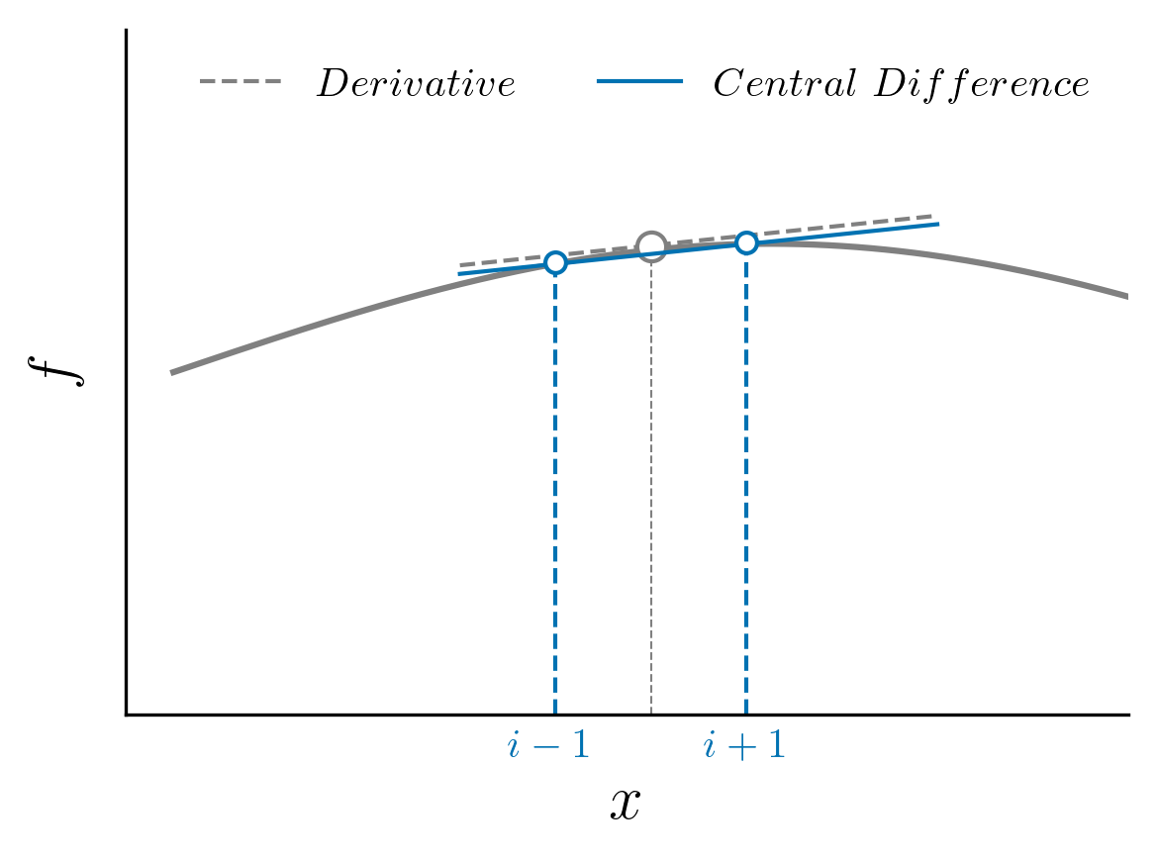
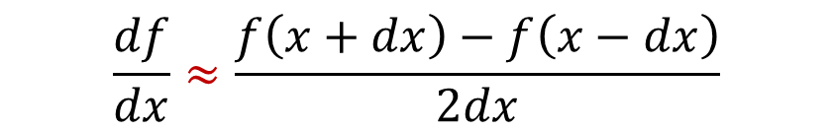
Finite Difference Method
Finite Difference
$$\frac{df}{dx}≈\frac{f\left(x+dx\right)−f\left(x\right)}{dx}$$
Forward
$$\frac{df}{dx}≈\frac{f\left(x\right)−f\left(x−dx\right)}{dx}$$
Backward
$$\frac{df}{dx}≈\frac{f\left(x+dx\right)−f\left(x−dx\right)}{2dx}$$
Centered

Slide 30
Finite Difference Method
Finite Difference
$$\frac{df}{dx}≈\frac{f\left(x+dx\right)−f\left(x\right)}{dx}$$
Forward
$$\frac{df}{dx}≈\frac{f\left(x\right)−f\left(x−dx\right)}{dx}$$
Backward
$$\frac{df}{dx}≈\frac{f\left(x+dx\right)−f\left(x−dx\right)}{2dx}$$
How good is the approximation?
Centered

Slide 31
How good is the approximation?

Slide 32
How good is the approximation?
Taylor Series
$$f\left(x_{0}+dx\right)=f\left(x_{0}\right)+\frac{df}{dx}{\left.​\right|}_{x_{0}}dx+\frac{1}{2!}\frac{d^{2}f}{dx^{2}}{\left.​\right|}_{x_{0}}dx^{2}+\frac{1}{3!}\frac{d^{3}f}{dx^{3}}{\left.​\right|}_{x_{0}}dx^{3}+…$$

Slide 33
How good is the approximation?
Taylor Series
$$f\left(x_{0}+dx\right)=f\left(x_{0}\right)+\frac{df}{dx}{\left.​\right|}_{x_{0}}dx+\frac{1}{2!}\frac{d^{2}f}{dx^{2}}{\left.​\right|}_{x_{0}}dx^{2}+\frac{1}{3!}\frac{d^{3}f}{dx^{3}}{\left.​\right|}_{x_{0}}dx^{3}+…$$
$$\frac{f\left(x_{0}+dx\right)−f\left(x_{0}\right)}{dx}=\frac{df}{dx}{\left.​\right|}_{x_{0}}+\frac{1}{2!}\frac{d^{2}f}{dx^{2}}{\left.​\right|}_{x_{0}}dx+\frac{1}{3!}\frac{d^{3}f}{dx^{3}}{\left.​\right|}_{x_{0}}dx^{2}+…$$

Slide 34
How good is the approximation?
Taylor Series
$$f\left(x_{0}+dx\right)=f\left(x_{0}\right)+\frac{df}{dx}{\left.​\right|}_{x_{0}}dx+\frac{1}{2!}\frac{d^{2}f}{dx^{2}}{\left.​\right|}_{x_{0}}dx^{2}+\frac{1}{3!}\frac{d^{3}f}{dx^{3}}{\left.​\right|}_{x_{0}}dx^{3}+…$$
$$\frac{f\left(x_{0}+dx\right)−f\left(x_{0}\right)}{dx}=\frac{df}{dx}{\left.​\right|}_{x_{0}}+\frac{1}{2!}\frac{d^{2}f}{dx^{2}}{\left.​\right|}_{x_{0}}dx+\frac{1}{3!}\frac{d^{3}f}{dx^{3}}{\left.​\right|}_{x_{0}}dx^{2}+…$$
$$\frac{f\left(x_{0}+dx\right)−f\left(x_{0}\right)}{dx}=\frac{df}{dx}{\left.​\right|}_{x_{0}}+O(dx)$$

Slide 35
How good is the approximation?
Taylor Series
$$f\left(x_{0}+dx\right)=f\left(x_{0}\right)+\frac{df}{dx}{\left.​\right|}_{x_{0}}dx+\frac{1}{2!}\frac{d^{2}f}{dx^{2}}{\left.​\right|}_{x_{0}}dx^{2}+\frac{1}{3!}\frac{d^{3}f}{dx^{3}}{\left.​\right|}_{x_{0}}dx^{3}+…$$
$$\frac{f\left(x_{0}+dx\right)−f\left(x_{0}\right)}{dx}=\frac{df}{dx}{\left.​\right|}_{x_{0}}+\frac{1}{2!}\frac{d^{2}f}{dx^{2}}{\left.​\right|}_{x_{0}}dx+\frac{1}{3!}\frac{d^{3}f}{dx^{3}}{\left.​\right|}_{x_{0}}dx^{2}+…$$
$$\frac{f\left(x_{0}+dx\right)−f\left(x_{0}\right)}{dx}=\frac{df}{dx}{\left.​\right|}_{x_{0}}+O(dx)$$

Slide 36
How good is the approximation?
Taylor Series
$$f\left(x_{0}+dx\right)=f\left(x_{0}\right)+\frac{df}{dx}{\left.​\right|}_{x_{0}}dx+\frac{1}{2!}\frac{d^{2}f}{dx^{2}}{\left.​\right|}_{x_{0}}dx^{2}+\frac{1}{3!}\frac{d^{3}f}{dx^{3}}{\left.​\right|}_{x_{0}}dx^{3}+…$$
$$\frac{f\left(x_{0}+dx\right)−f\left(x_{0}\right)}{dx}=\frac{df}{dx}{\left.​\right|}_{x_{0}}+\frac{1}{2!}\frac{d^{2}f}{dx^{2}}{\left.​\right|}_{x_{0}}dx+\frac{1}{3!}\frac{d^{3}f}{dx^{3}}{\left.​\right|}_{x_{0}}dx^{2}+…$$
$$\frac{f\left(x_{0}+dx\right)−f\left(x_{0}\right)}{dx}=\frac{df}{dx}{\left.​\right|}_{x_{0}}+O(dx)$$
1st order accurate

Slide 37
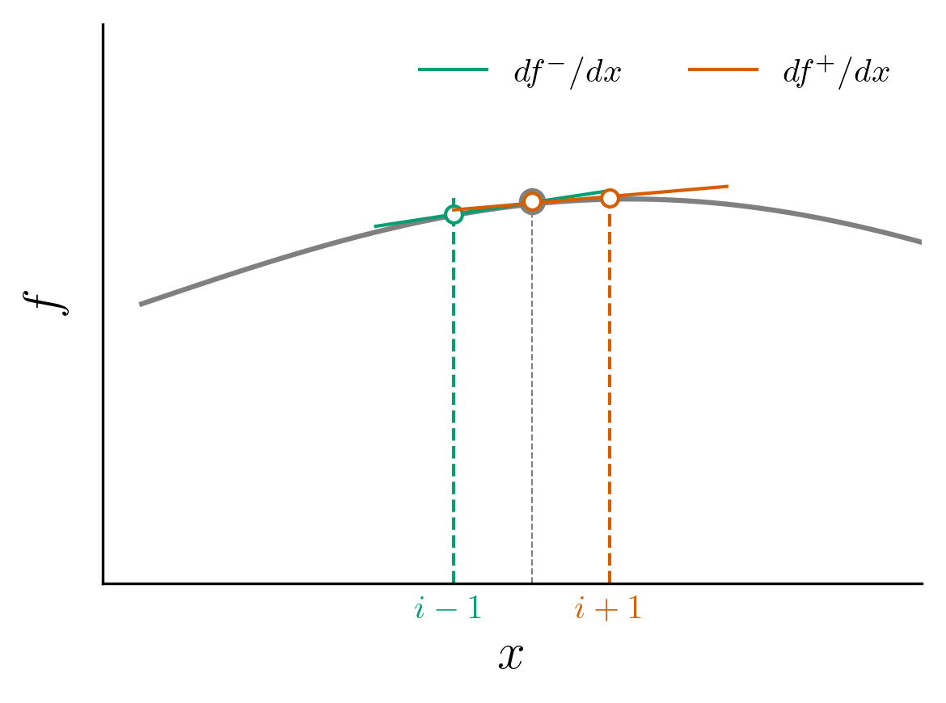

Second derivative
$$\frac{{\left.\frac{df}{dx}\right|}^{+}−{ \left.\frac{df}{dx}\right|}^{−}}{dx}≈\frac{d^{2}f}{dx^{2}}$$

Slide 38

Second derivative
$$\frac{{\left.\frac{df}{dx}\right|}^{+}−{ \left.\frac{df}{dx}\right|}^{−}}{dx}≈\frac{d^{2}f}{dx^{2}}$$
$$\frac{\frac{f\left(x+dx\right)−f\left(x\right)}{dx}−\frac{f\left(x+dx\right)−f\left(x\right)}{dx}}{dx}≈\frac{d^{2}f}{dx^{2}}$$

Slide 39
Second derivative
$$\frac{{\left.\frac{df}{dx}\right|}^{+}−{ \left.\frac{df}{dx}\right|}^{−}}{dx}≈\frac{d^{2}f}{dx^{2}}$$
$$\frac{\frac{f\left(x+dx\right)−f\left(x\right)}{dx}−\frac{f\left(x+dx\right)−f\left(x\right)}{dx}}{dx}≈\frac{d^{2}f}{dx^{2}}$$
$$\frac{f\left(x+dx\right)−2f\left(x\right)+f(x−dx)}{dx^{2}}≈\frac{d^{2}f}{dx^{2} }$$

Slide 40
Second derivative
$$\frac{{\left.\frac{df}{dx}\right|}^{+}−{ \left.\frac{df}{dx}\right|}^{−}}{dx}≈\frac{d^{2}f}{dx^{2}}$$
$$\frac{\frac{f\left(x+dx\right)−f\left(x\right)}{dx}−\frac{f\left(x+dx\right)−f\left(x\right)}{dx}}{dx}≈\frac{d^{2}f}{dx^{2}}$$
$$\frac{f\left(x+dx\right)−2f\left(x\right)+f(x−dx)}{dx^{2}}≈\frac{d^{2}f}{dx^{2} }$$
Central Differencing formula for 2nd derivative

Slide 41
Derivative Operators
Taylor Series
$$a\left[f\left(x+dx\right)\right]=a\left[f\left(x\right)+f^{′}\left(x\right)dx+\frac{1}{2!}f^{′′}\left(x\right)dx^{2}+…\right]$$
$$b[f\left(x\right)]=b[f\left(x\right)]$$
$$c[f\left(x−dx\right)]=c\left[f\left(x\right)−f^{′}\left(x\right)dx+\frac{1}{2!}f^{′′}\left(x\right)dx^{2}+…\right]$$

Slide 42
Derivative Operators
Taylor Series
$$a\left[f\left(x+dx\right)\right]=a\left[f\left(x\right)+f^{′}\left(x\right)dx+\frac{1}{2!}f^{′′}\left(x\right)dx^{2}+…\right]$$
$$b[f\left(x\right)]=b[f\left(x\right)]$$
$$c[f\left(x−dx\right)]=c\left[f\left(x\right)−f^{′}\left(x\right)dx+\frac{1}{2!}f^{′′}\left(x\right)dx^{2}+…\right]$$

Slide 43
Derivative Operators
Taylor Series
$$a\left[f\left(x+dx\right)\right]=a\left[f\left(x\right)+f^{′}\left(x\right)dx+\frac{1}{2!}f^{′′}\left(x\right)dx^{2}+…\right]$$
$$b[f\left(x\right)]=b[f\left(x\right)]$$
$$c[f\left(x−dx\right)]=c\left[f\left(x\right)−f^{′}\left(x\right)dx+\frac{1}{2!}f^{′′}\left(x\right)dx^{2}+…\right]$$
$$af\left(x+dx\right)+bf\left(x\right)+cf\left(x−dx\right)≈\left(a+b+c\right)f\left(x\right)+\left(a−c\right)f^{′}\left(x\right)dx+\frac{\left(a+c\right)}{2}f^{′′}\left(x\right)dx^{2}$$

Slide 44
Derivative Operators
$$af\left(x+dx\right)+bf\left(x\right)+cf\left(x−dx\right)≈\left(a+b+c\right)f\left(x\right)+\left(a−c\right)f^{′}\left(x\right)dx+\frac{\left(a+c\right)}{2}f^{′′}\left(x\right)dx^{2}$$

Slide 45
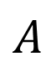
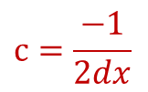
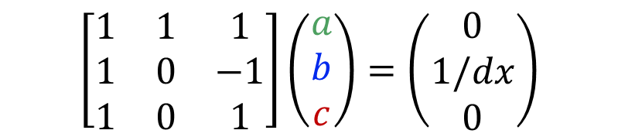
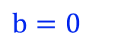
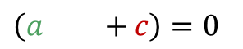
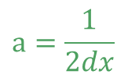
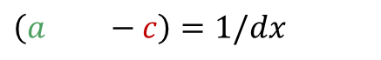
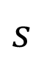
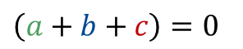
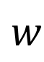
Derivative Operators
$$af\left(x+dx\right)+bf\left(x\right)+cf\left(x−dx\right)≈\left(a+b+c\right)f\left(x\right)+\left(a−c\right)f^{′}\left(x\right)dx+\frac{\left(a+c\right)}{2}f^{′′}\left(x\right)dx^{2}$$
1st Derivative
$$A$$
$$w$$
$$s$$
$$a=\frac{1}{2dx}$$
$$\left(a+b+c\right)=0$$
$$\left[\begin{matrix}1 & 1 & 1 \\ 1 & 0 & −1 \\ 1 & 0 & 1\end{matrix}\right]\left(\begin{matrix}a \\ b \\ c\end{matrix}\right)=\left(\begin{matrix}0 \\ 1/dx \\ 0\end{matrix}\right)$$
Inversion
$$\left(a+b−c\right)=1/dx$$
$$b=0$$
$$\left(a+b+c\right)=0$$
$$c=\frac{−1}{2dx}$$

Slide 46
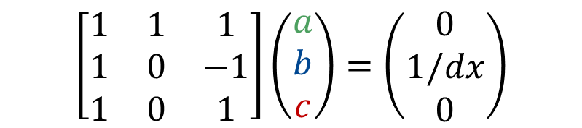
Derivative Operators
$$af\left(x+dx\right)+bf\left(x\right)+cf\left(x−dx\right)≈\left(a+b+c\right)f\left(x\right)+\left(a−c\right)f^{′}\left(x\right)dx+\frac{\left(a+c\right)}{2}f^{′′}\left(x\right)dx^{2}$$
1st Derivative
$$A$$
$$w$$
$$s$$
$$a=\frac{1}{2dx}$$
$$\left(a+b+c\right)=0$$
$$\left[\begin{matrix}1 & 1 & 1 \\ 1 & 0 & −1 \\ 1 & 0 & 1\end{matrix}\right]\left(\begin{matrix}a \\ b \\ c\end{matrix}\right)=\left(\begin{matrix}0 \\ 1/dx \\ 0\end{matrix}\right)$$
Inversion
$$\left(a+b−c\right)=1/dx$$
$$b=0$$
$$\left(a+b+c\right)=0$$
$$c=\frac{−1}{2dx}$$

Slide 47
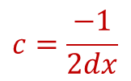
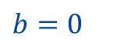
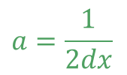
Derivative Operators
$$af\left(x+dx\right)+bf\left(x\right)+cf\left(x−dx\right)≈\left(a+b+c\right)f\left(x\right)+\left(a−c\right)f^{′}\left(x\right)dx+\frac{\left(a+c\right)}{2}f^{′′}\left(x\right)dx^{2}$$
1st Derivative
$$A$$
$$w$$
$$s$$
$$a=\frac{1}{2dx}$$
$$\left(a+b+c\right)=0$$
$$\left[\begin{matrix}1 & 1 & 1 \\ 1 & 0 & −1 \\ 1 & 0 & 1\end{matrix}\right]\left(\begin{matrix}a \\ b \\ c\end{matrix}\right)=\left(\begin{matrix}0 \\ 1/dx \\ 0\end{matrix}\right)$$
Inversion
$$\left(a+b−c\right)=1/dx$$
$$b=0$$
$$\left(a+b+c\right)=0$$
$$c=\frac{−1}{2dx}$$

Slide 48
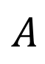
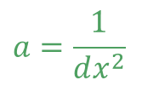
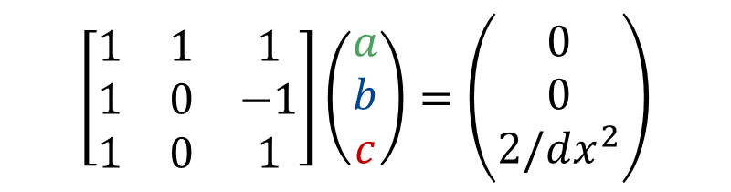








Derivative Operators
$$af\left(x+dx\right)+bf\left(x\right)+cf\left(x−dx\right)≈\left(a+b+c\right)f\left(x\right)+\left(a−c\right)f^{′}\left(x\right)dx+\frac{\left(a+c\right)}{2}f^{′′}\left(x\right)dx^{2}$$
1st Derivative
$$A$$
$$w$$
$$s$$
$$a=\frac{1}{2dx}$$
$$\left(a+b+c\right)=0$$
$$\left[\begin{matrix}1 & 1 & 1 \\ 1 & 0 & −1 \\ 1 & 0 & 1\end{matrix}\right]\left(\begin{matrix}a \\ b \\ c\end{matrix}\right)=\left(\begin{matrix}0 \\ 1/dx \\ 0\end{matrix}\right)$$
Inversion
$$\left(a+b−c\right)=1/dx$$
$$b=0$$
$$\left(a+b+c\right)=0$$
$$c=\frac{−1}{2dx}$$
2nd Derivative
$$A$$
$$w$$
$$s$$
$$a=\frac{1}{dx^{2}}$$
$$\left(a+b+c\right)=0$$
$$\left[\begin{matrix}1 & 1 & 1 \\ 1 & 0 & −1 \\ 1 & 0 & 1\end{matrix}\right]\left(\begin{matrix}a \\ b \\ c\end{matrix}\right)=\left(\begin{matrix}0 \\ 0 \\ 2/dx^{2}\end{matrix}\right)$$
Inversion
$$\left(a+b−c\right)=0$$
$$b=\frac{−2}{dx^{2}}$$
$$\left(a+b+c\right)=2!/dx^{2}$$
$$c=\frac{1}{dx^{2}}$$

Slide 49

Finite Difference in action
$$\frac{du}{dt}+c\frac{du}{dx}=0$$
1D Linear Convection

Slide 50


Finite Difference in action
$$\frac{du}{dt}+c\frac{du}{dx}=0$$
1D Linear Convection
Initial Condition:
$$u(x,0)=u_{0}(x)$$
Exact Solution:
$$u(x,t)=u_{0}(x−ct)$$

Slide 51
Finite Difference in action
$$\frac{du}{dt}+c\frac{du}{dx}=0$$
1D Linear Convection
With an Initial Condition (given as a wave), the equation represents propagation of a wave with a speed c, without change in its shape!
Initial Condition:
$$u(x,0)=u_{0}(x)$$
Exact Solution:
$$u(x,t)=u_{0}(x−ct)$$

Slide 52
Finite Difference in action
$$\frac{du}{dt}+c\frac{du}{dx}=0$$
1D Linear Convection
With an Initial Condition (given as a wave), the equation represents propagation of a wave with a speed c, without change in its shape!
Initial Condition:
$$u(x,0)=u_{0}(x)$$
Exact Solution:
$$u(x,t)=u_{0}(x−ct)$$

Slide 53
Finite Difference in action
$$\frac{du}{dt}+c\frac{du}{dx}=0$$
1D Linear Convection

Slide 54

Finite Difference in action
$$\frac{du}{dt}+c\frac{du}{dx}=0$$
1D Linear Convection
$$\frac{du}{dx}≈\frac{u\left(x\right)−u\left(x−Δx\right)}{Δx}$$
Backward Difference

Slide 55

Finite Difference in action
$$\frac{du}{dt}+c\frac{du}{dx}=0$$
1D Linear Convection
$$\frac{du}{dx}≈\frac{u\left(x\right)−u\left(x−Δx\right)}{Δx}$$
Backward Difference
$$\frac{du}{dt}≈\frac{u^{n+1}\left(x\right)−u^{n}\left(x\right)}{Δt}$$
Forward Euler

Slide 56

Finite Difference in action
$$\frac{du}{dt}+c\frac{du}{dx}=0$$
1D Linear Convection
$$\frac{du}{dx}≈\frac{u\left(x\right)−u\left(x−Δx\right)}{Δx}$$
Backward Difference
$$\frac{u_{i}^{n+1}−u_{i}^{n}}{Δt}+c\frac{u_{i}^{n}−u_{i−1}^{n}}{Δx}=0$$
$$\frac{du}{dt}≈\frac{u^{n+1}\left(x\right)−u^{n}\left(x\right)}{Δt}$$
Forward Euler

Slide 57

Finite Difference in action
$$\frac{du}{dt}+c\frac{du}{dx}=0$$
1D Linear Convection
$$\frac{du}{dx}≈\frac{u\left(x\right)−u\left(x−Δx\right)}{Δx}$$
Backward Difference
$$\frac{u_{i}^{n+1}−u_{i}^{n}}{Δt}+c\frac{u_{i}^{n}−u_{i−1}^{n}}{Δx}=0$$
$$\frac{du}{dt}≈\frac{u^{n+1}\left(x\right)−u^{n}\left(x\right)}{Δt}$$
Forward Euler
$$u_{i}^{n+1} =u_{i}^{n}−\frac{cΔt}{Δx}(u_{i}^{n}−u_{i−1}^{n})$$

Slide 58
Finite Difference in action
$$\frac{du}{dt}+c\frac{du}{dx}=0$$
1D Linear Convection
$$\frac{du}{dx}≈\frac{u\left(x\right)−u\left(x−Δx\right)}{Δx}$$
Backward Difference
$$\frac{u_{i}^{n+1}−u_{i}^{n}}{Δt}+c\frac{u_{i}^{n}−u_{i−1}^{n}}{Δx}=0$$
$$\frac{du}{dt}≈\frac{u^{n+1}\left(x\right)−u^{n}\left(x\right)}{Δt}$$
Forward Euler
$$u_{i}^{n+1} =u_{i}^{n}−\frac{cΔt}{Δx}(u_{i}^{n}−u_{i−1}^{n})$$
Let’s write our 1st CFD code !
Barba et al., (2018). CFD Python: the 12 steps to Navier-Stokes equations. Journal of Open-Source Education, 1(9), 21. https://doi.org/10. 21105/jose.00021

Slide 59
1st Code: 1D Linear Convection
import numpy as np
import matplotlib.pyplot as plt
import time, sys

Slide 60
1st Code: 1D Linear Convection
import numpy as np
import matplotlib.pyplot as plt
import time, sys
nx = 41
dx = 2/(nx-1)
nt = 25
dt = 0.025
c = 1

Slide 61


1st Code: 1D Linear Convection
import numpy as np
import matplotlib.pyplot as plt
import time, sys
The initial velocity $u_{0}$ is given as $2$ in the interval $0.5≤x≤1$ and $1$ elsewhere in $(0,2)⟹$ Hat function
nx = 41
dx = 2/(nx-1)
nt = 25
dt = 0.025
c = 1

Slide 62
1st Code: 1D Linear Convection
import numpy as np
import matplotlib.pyplot as plt
import time, sys
The initial velocity $u_{0}$ is given as $2$ in the interval $0.5≤x≤1$ and $1$ elsewhere in $(0,2)⟹$ Hat function
nx = 41
dx = 2/(nx-1)
nt = 25
dt = 0.025
c = 1
u = np.ones(nx)
u[int(0.5/dx):int(1/dx+1)] = 2
print(u)
plt.plot(np.linspace(0,2,nx), u)

Slide 63

1st Code: 1D Linear Convection
import numpy as np
import matplotlib.pyplot as plt
import time, sys
The initial velocity $u_{0}$ is given as $2$ in the interval $0.5≤x≤1$ and $1$ elsewhere in $(0,2)⟹$ Hat function
nx = 41
dx = 2/(nx-1)
nt = 25
dt = 0.025
c = 1
u = np.ones(nx)
u[int(0.5/dx):int(1/dx+1)] = 2
print(u)
plt.plot(np.linspace(0,2,nx), u)
un = np.ones(nx)
for n in range(nt):
un=u.copy()
for i in range(1,nx):
u[i] = un[i] – c * dt/dx * (un[i]-un[i-1])
plt.plot(np.linspace(0,2,nx), u)

Slide 64

1st Code: 1D Linear Convection
import numpy as np
import matplotlib.pyplot as plt
import time, sys
The initial velocity $u_{0}$ is given as $2$ in the interval $0.5≤x≤1$ and $1$ elsewhere in $(0,2)⟹$ Hat function
nx = 41
dx = 2/(nx-1)
nt = 25
dt = 0.025
c = 1
u = np.ones(nx)
u[int(0.5/dx):int(1/dx+1)] = 2
print(u)
plt.plot(np.linspace(0,2,nx), u)
un = np.ones(nx)
for n in range(nt):
un=u.copy()
for i in range(1,nx):
u[i] = un[i] – c * dt/dx * (un[i]-un[i-1])
plt.plot(np.linspace(0,2,nx), u)

Slide 65
1st Code: 1D Linear Convection
import numpy as np
import matplotlib.pyplot as plt
import time, sys
The initial velocity $u_{0}$ is given as $2$ in the interval $0.5≤x≤1$ and $1$ elsewhere in $(0,2)⟹$ Hat function
nx = 41
dx = 2/(nx-1)
nt = 25
dt = 0.025
c = 1
u = np.ones(nx)
u[int(0.5/dx):int(1/dx+1)] = 2
print(u)
plt.plot(np.linspace(0,2,nx), u)
un = np.ones(nx)
for n in range(nt):
un=u.copy()
for i in range(1,nx):
u[i] = un[i] – c * dt/dx * (un[i]-un[i-1])
plt.plot(np.linspace(0,2,nx), u)
Ok, so our hat function moved to the right, but it’s no longer a hat. What’s going on?

Slide 66
1st Code: 1D Linear Convection
import numpy as np
import matplotlib.pyplot as plt
import time, sys
Let’s try with central differencing !
The initial velocity $u_{0}$ is given as $2$ in the interval $0.5≤x≤1$ and $1$ elsewhere in $(0,2)⟹$ Hat function
nx = 41
dx = 2/(nx-1)
nt = 25
dt = 0.025
c = 1
u = np.ones(nx)
u[int(0.5/dx):int(1/dx+1)] = 2
print(u)
plt.plot(np.linspace(0,2,nx), u)
un = np.ones(nx)
for n in range(nt):
un=u.copy()
for i in range(1,nx):
u[i] = un[i] – c * dt/dx * (un[i]-un[i-1])
plt.plot(np.linspace(0,2,nx), u)
Ok, so our hat function moved to the right, but it’s no longer a hat. What’s going on?

Slide 67
1st Code: 1D Linear Convection
import numpy as np
import matplotlib.pyplot as plt
import time, sys
Let’s try with central differencing !
The initial velocity $u_{0}$ is given as $2$ in the interval $0.5≤x≤1$ and $1$ elsewhere in $(0,2)⟹$ Hat function
nx = 41
dx = 2/(nx-1)
nt = 25
dt = 0.025
c = 1
u = np.ones(nx)
u[int(0.5/dx):int(1/dx+1)] = 2
print(u)
plt.plot(np.linspace(0,2,nx), u)
un = np.ones(nx)
for n in range(nt):
un=u.copy()
for i in range(1,nx):
u[i] = un[i] – c * dt/dx * (un[i]-un[i-1])
plt.plot(np.linspace(0,2,nx), u)
Change these !
Ok, so our hat function moved to the right, but it’s no longer a hat. What’s going on?

Slide 68
1st Code: 1D Linear Convection
import numpy as np
import matplotlib.pyplot as plt
import time, sys
Let’s try with central differencing !
The initial velocity $u_{0}$ is given as $2$ in the interval $0.5≤x≤1$ and $1$ elsewhere in $(0,2)⟹$ Hat function
nx = 41
dx = 2/(nx-1)
nt = 25
dt = 0.025
c = 1
u = np.ones(nx)
u[int(0.5/dx):int(1/dx+1)] = 2
print(u)
plt.plot(np.linspace(0,2,nx), u)
un = np.ones(nx)
for n in range(nt):
un=u.copy()
for i in range(1,nx-1):
u[i] = un[i] – c * dt/dx * (un[i+1]-un[i-1])
plt.plot(np.linspace(0,2,nx), u)
Change these !
Ok, so our hat function moved to the right, but it’s no longer a hat. What’s going on?

Slide 69

1st Code: 1D Linear Convection
import numpy as np
import matplotlib.pyplot as plt
import time, sys
Let’s try with central differencing !
The initial velocity $u_{0}$ is given as $2$ in the interval $0.5≤x≤1$ and $1$ elsewhere in $(0,2)⟹$ Hat function
nx = 41
dx = 2/(nx-1)
nt = 25
dt = 0.025
c = 1
u = np.ones(nx)
u[int(0.5/dx):int(1/dx+1)] = 2
print(u)
plt.plot(np.linspace(0,2,nx), u)
un = np.ones(nx)
for n in range(nt):
un=u.copy()
for i in range(1,nx-1):
u[i] = un[i] – c * dt/dx * (un[i+1]-un[i-1])
plt.plot(np.linspace(0,2,nx), u)
Ok, so our hat function moved to the right, but it’s no longer a hat. What’s going on?

Slide 70
1st Code: 1D Linear Convection
import numpy as np
import matplotlib.pyplot as plt
import time, sys
Let’s try with central differencing !
The initial velocity $u_{0}$ is given as $2$ in the interval $0.5≤x≤1$ and $1$ elsewhere in $(0,2)⟹$ Hat function
nx = 41
dx = 2/(nx-1)
nt = 25
dt = 0.025
c = 1
What’s that !
u = np.ones(nx)
u[int(0.5/dx):int(1/dx+1)] = 2
print(u)
plt.plot(np.linspace(0,2,nx), u)
un = np.ones(nx)
for n in range(nt):
un=u.copy()
for i in range(1,nx-1):
u[i] = un[i] – c * dt/dx * (un[i+1]-un[i-1])
plt.plot(np.linspace(0,2,nx), u)
Ok, so our hat function moved to the right, but it’s no longer a hat. What’s going on?

Slide 71


1D Linear Convection with Central Differencing in Space
$$\frac{du}{dt}+c\frac{du}{dx}=0$$
$$\frac{u_{i}^{n+1} −u_{i}^{n}}{Δt}+\frac{c}{2Δx}\left(u_{i+1}^{n}−u_{i−1}^{n}\right)=0$$

Slide 72
1D Linear Convection with Central Differencing in Space
$$\frac{du}{dt}+c\frac{du}{dx}=0$$
$$\frac{u_{i}^{n+1} −u_{i}^{n}}{Δt}+\frac{c}{2Δx}\left(u_{i+1}^{n}−u_{i−1}^{n}\right)=0$$
$$u_{i}^{n+1}=u_{i}^{n}+Δt\frac{∂u}{∂t}{\left.​\right|}_{i}^{n}+\frac{Δt^{2}}{2!}\frac{∂^{2}u}{∂t^{2}}{\left.​\right|}_{i}^{n}+\frac{Δt^{3}}{3!}\frac{∂^{3}u}{∂t^{3}}{\left.​\right|}_{i}^{n}+…$$

Slide 73
1D Linear Convection with Central Differencing in Space
$$\frac{du}{dt}+c\frac{du}{dx}=0$$
$$\frac{u_{i}^{n+1} −u_{i}^{n}}{Δt}+\frac{c}{2Δx}\left(u_{i+1}^{n}−u_{i−1}^{n}\right)=0$$
$$u_{i}^{n+1}=u_{i}^{n}+Δt\frac{∂u}{∂t}{\left.​\right|}_{i}^{n}+\frac{Δt^{2}}{2!}\frac{∂^{2}u}{∂t^{2}}{\left.​\right|}_{i}^{n}+\frac{Δt^{3}}{3!}\frac{∂^{3}u}{∂t^{3}}{\left.​\right|}_{i}^{n}+…$$
$$u_{i+1}^{n}=u_{i}^{n}+Δx\frac{∂u}{∂x}{\left.​\right|}_{i}^{n}+\frac{Δx^{2}}{2!}\frac{∂^{2}u}{∂x^{2}}{\left.​\right|}_{i}^{n}+\frac{Δx^{3}}{3!}\frac{∂^{3}u}{∂x^{3}}{\left.​\right|}_{i}^{n}+…$$

Slide 74
1D Linear Convection with Central Differencing in Space
$$\frac{du}{dt}+c\frac{du}{dx}=0$$
$$\frac{u_{i}^{n+1} −u_{i}^{n}}{Δt}+\frac{c}{2Δx}\left(u_{i+1}^{n}−u_{i−1}^{n}\right)=0$$
$$u_{i}^{n+1}=u_{i}^{n}+Δt\frac{∂u}{∂t}{\left.​\right|}_{i}^{n}+\frac{Δt^{2}}{2!}\frac{∂^{2}u}{∂t^{2}}{\left.​\right|}_{i}^{n}+\frac{Δt^{3}}{3!}\frac{∂^{3}u}{∂t^{3}}{\left.​\right|}_{i}^{n}+…$$
$$u_{i+1}^{n}=u_{i}^{n}+Δx\frac{∂u}{∂x}{\left.​\right|}_{i}^{n}+\frac{Δx^{2}}{2!}\frac{∂^{2}u}{∂x^{2}}{\left.​\right|}_{i}^{n}+\frac{Δx^{3}}{3!}\frac{∂^{3}u}{∂x^{3}}{\left.​\right|}_{i}^{n}+…$$
$$u_{i−1}^{n}=u_{i}^{n}−Δx\frac{∂u}{∂x}{\left.​\right|}_{i}^{n}+\frac{Δx^{2}}{2!}\frac{∂^{2}u}{∂x^{2}}{\left.​\right|}_{i}^{n}−\frac{Δx^{3}}{3!}\frac{∂^{3}u}{∂x^{3}}{\left.​\right|}_{i}^{n}+…$$

Slide 75
1D Linear Convection with Central Differencing in Space
$$\frac{du}{dt}+c\frac{du}{dx}=0$$
$$\frac{u_{i}^{n+1} −u_{i}^{n}}{Δt}+\frac{c}{2Δx}\left(u_{i+1}^{n}−u_{i−1}^{n}\right)=0$$
$$u_{i}^{n+1}=u_{i}^{n}+Δt\frac{∂u}{∂t}{\left.​\right|}_{i}^{n}+\frac{Δt^{2}}{2!}\frac{∂^{2}u}{∂t^{2}}{\left.​\right|}_{i}^{n}+\frac{Δt^{3}}{3!}\frac{∂^{3}u}{∂t^{3}}{\left.​\right|}_{i}^{n}+…$$
$$u_{i+1}^{n}=u_{i}^{n}+Δx\frac{∂u}{∂x}{\left.​\right|}_{i}^{n}+\frac{Δx^{2}}{2!}\frac{∂^{2}u}{∂x^{2}}{\left.​\right|}_{i}^{n}+\frac{Δx^{3}}{3!}\frac{∂^{3}u}{∂x^{3}}{\left.​\right|}_{i}^{n}+…$$
$$u_{i−1}^{n}=u_{i}^{n}−Δx\frac{∂u}{∂x}{\left.​\right|}_{i}^{n}+\frac{Δx^{2}}{2!}\frac{∂^{2}u}{∂x^{2}}{\left.​\right|}_{i}^{n}−\frac{Δx^{3}}{3!}\frac{∂^{3}u}{∂x^{3}}{\left.​\right|}_{i}^{n}+…$$
$$\frac{u_{i}^{n+1} −u_{i}^{n}}{Δt}+\frac{c}{2Δx}\left(u_{i+1}^{n}−u_{i−1}^{n}\right)−{\left(\frac{∂u}{∂t}+c\frac{∂u}{∂x} \right)}_{i}^{n}=\frac{Δt}{2!}\frac{∂^{2}u}{∂t^{2}}{\left.​\right|}_{i}^{n}+\frac{cΔx^{3}}{3!}\frac{∂^{3}u}{∂t^{3}}{\left.​\right|}_{i}^{n}+O(Δt^{2},Δx^{4})$$

Slide 76

1D Linear Convection with Central Differencing in Space
$$\frac{du}{dt}+c\frac{du}{dx}=0$$
$$\frac{u_{i}^{n+1} −u_{i}^{n}}{Δt}+\frac{c}{2Δx}\left(u_{i+1}^{n}−u_{i−1}^{n}\right)=0$$
$$u_{i}^{n+1}=u_{i}^{n}+Δt\frac{∂u}{∂t}{\left.​\right|}_{i}^{n}+\frac{Δt^{2}}{2!}\frac{∂^{2}u}{∂t^{2}}{\left.​\right|}_{i}^{n}+\frac{Δt^{3}}{3!}\frac{∂^{3}u}{∂t^{3}}{\left.​\right|}_{i}^{n}+…$$
$$u_{i+1}^{n}=u_{i}^{n}+Δx\frac{∂u}{∂x}{\left.​\right|}_{i}^{n}+\frac{Δx^{2}}{2!}\frac{∂^{2}u}{∂x^{2}}{\left.​\right|}_{i}^{n}+\frac{Δx^{3}}{3!}\frac{∂^{3}u}{∂x^{3}}{\left.​\right|}_{i}^{n}+…$$
$$u_{i−1}^{n}=u_{i}^{n}−Δx\frac{∂u}{∂x}{\left.​\right|}_{i}^{n}+\frac{Δx^{2}}{2!}\frac{∂^{2}u}{∂x^{2}}{\left.​\right|}_{i}^{n}−\frac{Δx^{3}}{3!}\frac{∂^{3}u}{∂x^{3}}{\left.​\right|}_{i}^{n}+…$$
$$\frac{u_{i}^{n+1} −u_{i}^{n}}{Δt}+\frac{c}{2Δx}\left(u_{i+1}^{n}−u_{i−1}^{n}\right)−{\left(\frac{∂u}{∂t}+c\frac{∂u}{∂x} \right)}_{i}^{n}=\frac{Δt}{2!}\frac{∂^{2}u}{∂t^{2}}{\left.​\right|}_{i}^{n}+\frac{cΔx^{3}}{3!}\frac{∂^{3}u}{∂t^{3}}{\left.​\right|}_{i}^{n}+O(Δt^{2},Δx^{4})$$
Truncation Error $(ε_{t})$

Slide 77
1D Linear Convection with Central Differencing in Space
$$\frac{du}{dt}+c\frac{du}{dx}=0$$
$$\frac{u_{i}^{n+1} −u_{i}^{n}}{Δt}+\frac{c}{2Δx}\left(u_{i+1}^{n}−u_{i−1}^{n}\right)=0$$
$$u_{i}^{n+1}=u_{i}^{n}+Δt\frac{∂u}{∂t}{\left.​\right|}_{i}^{n}+\frac{Δt^{2}}{2!}\frac{∂^{2}u}{∂t^{2}}{\left.​\right|}_{i}^{n}+\frac{Δt^{3}}{3!}\frac{∂^{3}u}{∂t^{3}}{\left.​\right|}_{i}^{n}+…$$
$$u_{i+1}^{n}=u_{i}^{n}+Δx\frac{∂u}{∂x}{\left.​\right|}_{i}^{n}+\frac{Δx^{2}}{2!}\frac{∂^{2}u}{∂x^{2}}{\left.​\right|}_{i}^{n}+\frac{Δx^{3}}{3!}\frac{∂^{3}u}{∂x^{3}}{\left.​\right|}_{i}^{n}+…$$
$$u_{i−1}^{n}=u_{i}^{n}−Δx\frac{∂u}{∂x}{\left.​\right|}_{i}^{n}+\frac{Δx^{2}}{2!}\frac{∂^{2}u}{∂x^{2}}{\left.​\right|}_{i}^{n}−\frac{Δx^{3}}{3!}\frac{∂^{3}u}{∂x^{3}}{\left.​\right|}_{i}^{n}+…$$
$$\frac{u_{i}^{n+1} −u_{i}^{n}}{Δt}+\frac{c}{2Δx}\left(u_{i+1}^{n}−u_{i−1}^{n}\right)−{\left(\frac{∂u}{∂t}+c\frac{∂u}{∂x} \right)}_{i}^{n}=\frac{Δt}{2!}\frac{∂^{2}u}{∂t^{2}}{\left.​\right|}_{i}^{n}+\frac{cΔx^{3}}{3!}\frac{∂^{3}u}{∂t^{3}}{\left.​\right|}_{i}^{n}+O(Δt^{2},Δx^{4})$$
Truncation Error $(ε_{t})$
As $Δt \& Δx⟶0:ε_{T}⟶0⇒$ Numerical Scheme is Consistent

Slide 78

1D Linear Convection with Central Differencing in Space
Consider the exact solution of the discretized equation:
$$\frac{\overline{u_{i}^{n+1}} −\overline{u_{i}^{n}}}{Δt}+\frac{c}{2Δx}\left(\overline{u_{i+1}^{n}}−\overline{u_{i−1}^{n}}\right)=0$$

Slide 79

1D Linear Convection with Central Differencing in Space
Consider the exact solution of the discretized equation:
$$\frac{\overline{u_{i}^{n+1}} −\overline{u_{i}^{n}}}{Δt}+\frac{c}{2Δx}\left(\overline{u_{i+1}^{n}}−\overline{u_{i−1}^{n}}\right)=0$$
$$−{\left(\frac{∂\overline{u}}{∂t}+c\frac{∂\overline{u}}{∂x} \right)}_{i}^{n}=\frac{Δt}{2!}\frac{∂^{2}\overline{u}}{∂t^{2}}{\left.​\right|}_{i}^{n}+\frac{cΔx^{3}}{3!}\frac{∂^{3}\overline{u}}{∂t^{3}}{\left.​\right|}_{i}^{n}+O(Δt^{2},Δx^{4})$$

Slide 80

1D Linear Convection with Central Differencing in Space
Consider the exact solution of the discretized equation:
$$\frac{\overline{u_{i}^{n+1}} −\overline{u_{i}^{n}}}{Δt}+\frac{c}{2Δx}\left(\overline{u_{i+1}^{n}}−\overline{u_{i−1}^{n}}\right)=0$$
$$−{\left(\frac{∂\overline{u}}{∂t}+c\frac{∂\overline{u}}{∂x} \right)}_{i}^{n}=\frac{Δt}{2!}\frac{∂^{2}\overline{u}}{∂t^{2}}{\left.​\right|}_{i}^{n}+\frac{cΔx^{3}}{3!}\frac{∂^{3}\overline{u}}{∂t^{3}}{\left.​\right|}_{i}^{n}+O(Δt^{2},Δx^{4})$$
$${\overline{(u_{t})}}_{i}^{n}={−c \overline{(u_{x})}}_{i}^{n}+O(Δt,Δx)$$

Slide 81

1D Linear Convection with Central Differencing in Space
Consider the exact solution of the discretized equation:
$$\frac{\overline{u_{i}^{n+1}} −\overline{u_{i}^{n}}}{Δt}+\frac{c}{2Δx}\left(\overline{u_{i+1}^{n}}−\overline{u_{i−1}^{n}}\right)=0$$
$$−{\left(\frac{∂\overline{u}}{∂t}+c\frac{∂\overline{u}}{∂x} \right)}_{i}^{n}=\frac{Δt}{2!}\frac{∂^{2}\overline{u}}{∂t^{2}}{\left.​\right|}_{i}^{n}+\frac{cΔx^{3}}{3!}\frac{∂^{3}\overline{u}}{∂t^{3}}{\left.​\right|}_{i}^{n}+O(Δt^{2},Δx^{4})$$
$${\overline{(u_{t})}}_{i}^{n}={−c \overline{(u_{x})}}_{i}^{n}+O(Δt,Δx)$$
$${\overline{(u_{tt})}}_{i}^{n}={−c \overline{(u_{xt})}}_{i}^{n}+O(Δt,Δx)$$

Slide 82

1D Linear Convection with Central Differencing in Space
Consider the exact solution of the discretized equation:
$$\frac{\overline{u_{i}^{n+1}} −\overline{u_{i}^{n}}}{Δt}+\frac{c}{2Δx}\left(\overline{u_{i+1}^{n}}−\overline{u_{i−1}^{n}}\right)=0$$
$$−{\left(\frac{∂\overline{u}}{∂t}+c\frac{∂\overline{u}}{∂x} \right)}_{i}^{n}=\frac{Δt}{2!}\frac{∂^{2}\overline{u}}{∂t^{2}}{\left.​\right|}_{i}^{n}+\frac{cΔx^{3}}{3!}\frac{∂^{3}\overline{u}}{∂t^{3}}{\left.​\right|}_{i}^{n}+O(Δt^{2},Δx^{4})$$
$${\overline{(u_{t})}}_{i}^{n}={−c \overline{(u_{x})}}_{i}^{n}+O(Δt,Δx)$$
$${\overline{(u_{tt})}}_{i}^{n}={−c \overline{(u_{xt})}}_{i}^{n}+O(Δt,Δx)$$
$${\overline{(u_{tt})}}_{i}^{n}={−c \overline{{\left[\left(u_{t}\right)\right]}_{x}}}_{i}^{n}+O(Δt,Δx)$$

Slide 83

1D Linear Convection with Central Differencing in Space
Consider the exact solution of the discretized equation:
$$\frac{\overline{u_{i}^{n+1}} −\overline{u_{i}^{n}}}{Δt}+\frac{c}{2Δx}\left(\overline{u_{i+1}^{n}}−\overline{u_{i−1}^{n}}\right)=0$$
$$−{\left(\frac{∂\overline{u}}{∂t}+c\frac{∂\overline{u}}{∂x} \right)}_{i}^{n}=\frac{Δt}{2!}\frac{∂^{2}\overline{u}}{∂t^{2}}{\left.​\right|}_{i}^{n}+\frac{cΔx^{3}}{3!}\frac{∂^{3}\overline{u}}{∂t^{3}}{\left.​\right|}_{i}^{n}+O(Δt^{2},Δx^{4})$$
$${\overline{(u_{t})}}_{i}^{n}={−c \overline{(u_{x})}}_{i}^{n}+O(Δt,Δx)$$
$${\overline{(u_{tt})}}_{i}^{n}={−c \overline{(u_{xt})}}_{i}^{n}+O(Δt,Δx)$$
$${\overline{(u_{tt})}}_{i}^{n}={−c \overline{{\left[\left(u_{t}\right)\right]}_{x}}}_{i}^{n}+O(Δt,Δx)$$
$${\overline{(u_{tt})}}_{i}^{n}={c^{2} \overline{u_{xx}}}_{i}^{n}+O(Δt,Δx)$$

Slide 84

1D Linear Convection with Central Differencing in Space
Consider the exact solution of the discretized equation:
$$\frac{\overline{u_{i}^{n+1}} −\overline{u_{i}^{n}}}{Δt}+\frac{c}{2Δx}\left(\overline{u_{i+1}^{n}}−\overline{u_{i−1}^{n}}\right)=0$$
$$−{\left(\frac{∂\overline{u}}{∂t}+c\frac{∂\overline{u}}{∂x} \right)}_{i}^{n}=\frac{Δt}{2!}\frac{∂^{2}\overline{u}}{∂t^{2}}{\left.​\right|}_{i}^{n}+\frac{cΔx^{3}}{3!}\frac{∂^{3}\overline{u}}{∂t^{3}}{\left.​\right|}_{i}^{n}+O(Δt^{2},Δx^{4})$$
$${\overline{(u_{t})}}_{i}^{n}={−c \overline{(u_{x})}}_{i}^{n}+O(Δt,Δx)$$
$${\overline{(u_{t})}}_{i}^{n}{+ c \overline{(u_{x})}}_{i}^{n} =−\frac{Δt}{2!}{c^{2} \overline{u_{xx}}}_{i}^{n}+O(Δt^{2},Δx^{2})$$
$${\overline{(u_{tt})}}_{i}^{n}={−c \overline{(u_{xt})}}_{i}^{n}+O(Δt,Δx)$$
$${\overline{(u_{tt})}}_{i}^{n}={−c \overline{{\left[\left(u_{t}\right)\right]}_{x}}}_{i}^{n}+O(Δt,Δx)$$
$${\overline{(u_{tt})}}_{i}^{n}={c^{2} \overline{u_{xx}}}_{i}^{n}+O(Δt,Δx)$$

Slide 85
1D Linear Convection with Central Differencing in Space
Consider the exact solution of the discretized equation:
$$\frac{\overline{u_{i}^{n+1}} −\overline{u_{i}^{n}}}{Δt}+\frac{c}{2Δx}\left(\overline{u_{i+1}^{n}}−\overline{u_{i−1}^{n}}\right)=0$$
$$−{\left(\frac{∂\overline{u}}{∂t}+c\frac{∂\overline{u}}{∂x} \right)}_{i}^{n}=\frac{Δt}{2!}\frac{∂^{2}\overline{u}}{∂t^{2}}{\left.​\right|}_{i}^{n}+\frac{cΔx^{3}}{3!}\frac{∂^{3}\overline{u}}{∂t^{3}}{\left.​\right|}_{i}^{n}+O(Δt^{2},Δx^{4})$$
$${\overline{(u_{t})}}_{i}^{n}={−c \overline{(u_{x})}}_{i}^{n}+O(Δt,Δx)$$
$${\overline{(u_{t})}}_{i}^{n}{+ c \overline{(u_{x})}}_{i}^{n} =−\frac{Δt}{2!}{c^{2} \overline{u_{xx}}}_{i}^{n}+O(Δt^{2},Δx^{2})$$
$${\overline{(u_{tt})}}_{i}^{n}={−c \overline{(u_{xt})}}_{i}^{n}+O(Δt,Δx)$$
Modified Differential Equation !
$${\overline{(u_{tt})}}_{i}^{n}={−c \overline{{\left[\left(u_{t}\right)\right]}_{x}}}_{i}^{n}+O(Δt,Δx)$$
$${\overline{(u_{tt})}}_{i}^{n}={c^{2} \overline{u_{xx}}}_{i}^{n}+O(Δt,Δx)$$

Slide 86
1D Linear Convection with Central Differencing in Space
Consider the exact solution of the discretized equation:
$$\frac{\overline{u_{i}^{n+1}} −\overline{u_{i}^{n}}}{Δt}+\frac{c}{2Δx}\left(\overline{u_{i+1}^{n}}−\overline{u_{i−1}^{n}}\right)=0$$
$$−{\left(\frac{∂\overline{u}}{∂t}+c\frac{∂\overline{u}}{∂x} \right)}_{i}^{n}=\frac{Δt}{2!}\frac{∂^{2}\overline{u}}{∂t^{2}}{\left.​\right|}_{i}^{n}+\frac{cΔx^{3}}{3!}\frac{∂^{3}\overline{u}}{∂t^{3}}{\left.​\right|}_{i}^{n}+O(Δt^{2},Δx^{4})$$
$${\overline{(u_{t})}}_{i}^{n}={−c \overline{(u_{x})}}_{i}^{n}+O(Δt,Δx)$$
$${\overline{(u_{t})}}_{i}^{n}{+ c \overline{(u_{x})}}_{i}^{n} =−\frac{Δt}{2!}{c^{2} \overline{u_{xx}}}_{i}^{n}+O(Δt^{2},Δx^{2})$$
$${\overline{(u_{tt})}}_{i}^{n}={−c \overline{(u_{xt})}}_{i}^{n}+O(Δt,Δx)$$
Modified Differential Equation !
NOT a convection equation, It is a Convection-Diffusion equation !!
$${\overline{(u_{tt})}}_{i}^{n}={−c \overline{{\left[\left(u_{t}\right)\right]}_{x}}}_{i}^{n}+O(Δt,Δx)$$
$${\overline{(u_{tt})}}_{i}^{n}={c^{2} \overline{u_{xx}}}_{i}^{n}+O(Δt,Δx)$$

Slide 87
1D Linear Convection with Central Differencing in Space
Consider the exact solution of the discretized equation:
$$\frac{\overline{u_{i}^{n+1}} −\overline{u_{i}^{n}}}{Δt}+\frac{c}{2Δx}\left(\overline{u_{i+1}^{n}}−\overline{u_{i−1}^{n}}\right)=0$$
-ve Diffusion Coefficient !!
$$−{\left(\frac{∂\overline{u}}{∂t}+c\frac{∂\overline{u}}{∂x} \right)}_{i}^{n}=\frac{Δt}{2!}\frac{∂^{2}\overline{u}}{∂t^{2}}{\left.​\right|}_{i}^{n}+\frac{cΔx^{3}}{3!}\frac{∂^{3}\overline{u}}{∂t^{3}}{\left.​\right|}_{i}^{n}+O(Δt^{2},Δx^{4})$$
$${\overline{(u_{t})}}_{i}^{n}={−c \overline{(u_{x})}}_{i}^{n}+O(Δt,Δx)$$
$${\overline{(u_{t})}}_{i}^{n}{+ c \overline{(u_{x})}}_{i}^{n} =−\frac{Δt}{2!}{c^{2} \overline{u_{xx}}}_{i}^{n}+O(Δt^{2},Δx^{2})$$
$${\overline{(u_{tt})}}_{i}^{n}={−c \overline{(u_{xt})}}_{i}^{n}+O(Δt,Δx)$$
Modified Differential Equation !
NOT a convection equation, It is a Convection-Diffusion equation !!
$${\overline{(u_{tt})}}_{i}^{n}={−c \overline{{\left[\left(u_{t}\right)\right]}_{x}}}_{i}^{n}+O(Δt,Δx)$$
$${\overline{(u_{tt})}}_{i}^{n}={c^{2} \overline{u_{xx}}}_{i}^{n}+O(Δt,Δx)$$

Slide 88
1D Linear Convection with Central Differencing in Space
Consider the exact solution of the discretized equation:
Explosion : Unstable Scheme !!
$$\frac{\overline{u_{i}^{n+1}} −\overline{u_{i}^{n}}}{Δt}+\frac{c}{2Δx}\left(\overline{u_{i+1}^{n}}−\overline{u_{i−1}^{n}}\right)=0$$
-ve Diffusion Coefficient !!
$$−{\left(\frac{∂\overline{u}}{∂t}+c\frac{∂\overline{u}}{∂x} \right)}_{i}^{n}=\frac{Δt}{2!}\frac{∂^{2}\overline{u}}{∂t^{2}}{\left.​\right|}_{i}^{n}+\frac{cΔx^{3}}{3!}\frac{∂^{3}\overline{u}}{∂t^{3}}{\left.​\right|}_{i}^{n}+O(Δt^{2},Δx^{4})$$
$${\overline{(u_{t})}}_{i}^{n}={−c \overline{(u_{x})}}_{i}^{n}+O(Δt,Δx)$$
$${\overline{(u_{t})}}_{i}^{n}{+ c \overline{(u_{x})}}_{i}^{n} =−\frac{Δt}{2!}{c^{2} \overline{u_{xx}}}_{i}^{n}+O(Δt^{2},Δx^{2})$$
$${\overline{(u_{tt})}}_{i}^{n}={−c \overline{(u_{xt})}}_{i}^{n}+O(Δt,Δx)$$
Modified Differential Equation !
NOT a convection equation, It is a Convection-Diffusion equation !!
$${\overline{(u_{tt})}}_{i}^{n}={−c \overline{{\left[\left(u_{t}\right)\right]}_{x}}}_{i}^{n}+O(Δt,Δx)$$
$${\overline{(u_{tt})}}_{i}^{n}={c^{2} \overline{u_{xx}}}_{i}^{n}+O(Δt,Δx)$$

Slide 89

1D Linear Convection with Backward Differencing in Space
Consider the exact solution of the discretized equation:
$$\frac{\overline{u_{i}^{n+1}} −\overline{u_{i}^{n}}}{Δt}+\frac{c}{2Δx}\left(\overline{u_{i}^{n}}−\overline{u_{i−1}^{n}}\right)=0$$

Slide 90

1D Linear Convection with Backward Differencing in Space
Consider the exact solution of the discretized equation:
$$\frac{\overline{u_{i}^{n+1}} −\overline{u_{i}^{n}}}{Δt}+\frac{c}{2Δx}\left(\overline{u_{i}^{n}}−\overline{u_{i−1}^{n}}\right)=0$$
$${\left(\frac{∂\overline{u}}{∂t}+c\frac{∂\overline{u}}{∂x} \right)}_{i}^{n}=\frac{cΔx}{2}\left(1−\frac{cΔt}{Δx} \right)\frac{∂^{2}\overline{u}}{∂x^{2}}{\left.​\right|}_{i}^{n}$$
Modified Differential Equation:
Convection-Diffusion equation !!

Slide 91
1D Linear Convection with Backward Differencing in Space
Consider the exact solution of the discretized equation:
$$\frac{\overline{u_{i}^{n+1}} −\overline{u_{i}^{n}}}{Δt}+\frac{c}{2Δx}\left(\overline{u_{i}^{n}}−\overline{u_{i−1}^{n}}\right)=0$$
$${\left(\frac{∂\overline{u}}{∂t}+c\frac{∂\overline{u}}{∂x} \right)}_{i}^{n}=\frac{cΔx}{2}\left(1−\frac{cΔt}{Δx} \right)\frac{∂^{2}\overline{u}}{∂x^{2}}{\left.​\right|}_{i}^{n}$$
Modified Differential Equation:
Convection-Diffusion equation !!
Diffusion Coefficient must be +ve !!

Slide 92
1D Linear Convection with Backward Differencing in Space
Consider the exact solution of the discretized equation:
$$\frac{\overline{u_{i}^{n+1}} −\overline{u_{i}^{n}}}{Δt}+\frac{c}{2Δx}\left(\overline{u_{i}^{n}}−\overline{u_{i−1}^{n}}\right)=0$$
$${\left(\frac{∂\overline{u}}{∂t}+c\frac{∂\overline{u}}{∂x} \right)}_{i}^{n}=\frac{cΔx}{2}\left(1−\frac{cΔt}{Δx} \right)\frac{∂^{2}\overline{u}}{∂x^{2}}{\left.​\right|}_{i}^{n}$$
Modified Differential Equation:
Convection-Diffusion equation !!
Diffusion Coefficient must be +ve !!
$$0≤\frac{cΔt}{Δx} ≤1$$
For stability, we need:

Slide 93
1D Linear Convection with Backward Differencing in Space
Consider the exact solution of the discretized equation:
$$\frac{\overline{u_{i}^{n+1}} −\overline{u_{i}^{n}}}{Δt}+\frac{c}{2Δx}\left(\overline{u_{i}^{n}}−\overline{u_{i−1}^{n}}\right)=0$$
$${\left(\frac{∂\overline{u}}{∂t}+c\frac{∂\overline{u}}{∂x} \right)}_{i}^{n}=\frac{cΔx}{2}\left(1−\frac{cΔt}{Δx} \right)\frac{∂^{2}\overline{u}}{∂x^{2}}{\left.​\right|}_{i}^{n}$$
Modified Differential Equation:
Convection-Diffusion equation !!
Diffusion Coefficient must be +ve !!
$$0≤\frac{cΔt}{Δx} ≤1$$
For stability, we need:
Courant-Friedrich-Lewy (CFL) Number!!

Slide 94
1D Linear Convection with Backward Differencing in Space
Consider the exact solution of the discretized equation:
$$\frac{\overline{u_{i}^{n+1}} −\overline{u_{i}^{n}}}{Δt}+\frac{c}{2Δx}\left(\overline{u_{i}^{n}}−\overline{u_{i−1}^{n}}\right)=0$$
$${\left(\frac{∂\overline{u}}{∂t}+c\frac{∂\overline{u}}{∂x} \right)}_{i}^{n}=\frac{cΔx}{2}\left(1−\frac{cΔt}{Δx} \right)\frac{∂^{2}\overline{u}}{∂x^{2}}{\left.​\right|}_{i}^{n}$$
Modified Differential Equation:
Convection-Diffusion equation !!
Diffusion Coefficient must be +ve !!
$$0≤\frac{cΔt}{Δx} ≤1$$
For stability, we need:
For a CFL of $<1:$ Numerical Diffusion is of $O(Δx)$
Courant-Friedrich-Lewy (CFL) Number!!

Slide 95
1D Linear Convection with Backward Differencing in Space
Consider the exact solution of the discretized equation:
$$\frac{\overline{u_{i}^{n+1}} −\overline{u_{i}^{n}}}{Δt}+\frac{c}{2Δx}\left(\overline{u_{i}^{n}}−\overline{u_{i−1}^{n}}\right)=0$$
$${\left(\frac{∂\overline{u}}{∂t}+c\frac{∂\overline{u}}{∂x} \right)}_{i}^{n}=\frac{cΔx}{2}\left(1−\frac{cΔt}{Δx} \right)\frac{∂^{2}\overline{u}}{∂x^{2}}{\left.​\right|}_{i}^{n}$$
Modified Differential Equation:
Convection-Diffusion equation !!
Diffusion Coefficient must be +ve !!
$$0≤\frac{cΔt}{Δx} ≤1$$
For stability, we need:
For a CFL of $<1:$ Numerical Diffusion is of $O(Δx)$
Courant-Friedrich-Lewy (CFL) Number!!
Poor Accuracy !!

Slide 96
2nd Code: 1D non-Linear Convection
import numpy as np
import matplotlib.pyplot as plt
import time, sys
The initial velocity $u_{0}$ is given as $2$ in the interval $0.5≤x≤1$ and $1$ elsewhere in $(0,2)⟹$ Hat function
nx = 41
dx = 2/(nx-1)
nt = 25
dt = 0.025
c = 1
u = np.ones(nx)
u[int(0.5/dx):int(1/dx+1)] = 2
print(u)
plt.plot(np.linspace(0,2,nx), u)
un = np.ones(nx)
for n in range(nt):
un=u.copy()
for i in range(1,nx):
u[i] = un[i] – c * dt/dx * (un[i]-un[i-1])
plt.plot(np.linspace(0,2,nx), u)

Slide 97
2nd Code: 1D non-Linear Convection
import numpy as np
import matplotlib.pyplot as plt
import time, sys
The initial velocity $u_{0}$ is given as $2$ in the interval $0.5≤x≤1$ and $1$ elsewhere in $(0,2)⟹$ Hat function
nx = 41
dx = 2/(nx-1)
nt = 25
dt = 0.025
c = 1
u = np.ones(nx)
u[int(0.5/dx):int(1/dx+1)] = 2
print(u)
plt.plot(np.linspace(0,2,nx), u)
un = np.ones(nx)
for n in range(nt):
un=u.copy()
for i in range(1,nx):
u[i] = un[i] – c * dt/dx * (un[i]-un[i-1])
plt.plot(np.linspace(0,2,nx), u)
Change this only !

Slide 98
2nd Code: 1D non-Linear Convection
import numpy as np
import matplotlib.pyplot as plt
import time, sys
The initial velocity $u_{0}$ is given as $2$ in the interval $0.5≤x≤1$ and $1$ elsewhere in $(0,2)⟹$ Hat function
nx = 41
dx = 2/(nx-1)
nt = 25
dt = 0.025
c = 1
u = np.ones(nx)
u[int(0.5/dx):int(1/dx+1)] = 2
print(u)
plt.plot(np.linspace(0,2,nx), u)
un = np.ones(nx)
for n in range(nt):
un=u.copy()
for i in range(1,nx):
u[i] = un[i] – un[i] * dt/dx * (un[i]-un[i-1])
plt.plot(np.linspace(0,2,nx), u)

Slide 99

2nd Code: 1D non-Linear Convection
import numpy as np
import matplotlib.pyplot as plt
import time, sys
The initial velocity $u_{0}$ is given as $2$ in the interval $0.5≤x≤1$ and $1$ elsewhere in $(0,2)⟹$ Hat function
nx = 41
dx = 2/(nx-1)
nt = 25
dt = 0.025
c = 1
u = np.ones(nx)
u[int(0.5/dx):int(1/dx+1)] = 2
print(u)
plt.plot(np.linspace(0,2,nx), u)
un = np.ones(nx)
for n in range(nt):
un=u.copy()
for i in range(1,nx):
u[i] = un[i] – un[i] * dt/dx * (un[i]-un[i-1])
plt.plot(np.linspace(0,2,nx), u)

Slide 100
2nd Code: 1D non-Linear Convection
import numpy as np
import matplotlib.pyplot as plt
import time, sys
The initial velocity $u_{0}$ is given as $2$ in the interval $0.5≤x≤1$ and $1$ elsewhere in $(0,2)⟹$ Hat function
nx = 41
dx = 2/(nx-1)
nt = 25
dt = 0.025
c = 1
Let’s introduce CFL
u = np.ones(nx)
u[int(0.5/dx):int(1/dx+1)] = 2
print(u)
plt.plot(np.linspace(0,2,nx), u)
un = np.ones(nx)
for n in range(nt):
un=u.copy()
for i in range(1,nx):
u[i] = un[i] – un[i] * dt/dx * (un[i]-un[i-1])
plt.plot(np.linspace(0,2,nx), u)

Slide 101
2nd Code: 1D non-Linear Convection
import numpy as np
import matplotlib.pyplot as plt
import time, sys
The initial velocity $u_{0}$ is given as $2$ in the interval $0.5≤x≤1$ and $1$ elsewhere in $(0,2)⟹$ Hat function
nx = 41
dx = 2/(nx-1)
nt = 25
CFL = 0.9
Let’s introduce CFL
u = np.ones(nx)
u[int(0.5/dx):int(1/dx+1)] = 2
print(u)
plt.plot(np.linspace(0,2,nx), u)
dt = CFL*dx/max(abs(u))
un = np.ones(nx)
for n in range(nt):
un=u.copy()
for i in range(1,nx):
u[i] = un[i] – un[i] * dt/dx * (un[i]-un[i-1])
plt.plot(np.linspace(0,2,nx), u)

Slide 102
2nd Code: 1D non-Linear Convection
import numpy as np
import matplotlib.pyplot as plt
import time, sys
The initial velocity $u_{0}$ is given as $2$ in the interval $0.5≤x≤1$ and $1$ elsewhere in $(0,2)⟹$ Hat function
nx = 41
dx = 2/(nx-1)
nt = 25
CFL = 0.9
Let’s introduce CFL
u = np.ones(nx)
u[int(0.5/dx):int(1/dx+1)] = 2
print(u)
plt.plot(np.linspace(0,2,nx), u)
dt = CFL*dx/max(abs(u))
Play a bit & see what happens!
un = np.ones(nx)
for n in range(nt):
un=u.copy()
for i in range(1,nx):
u[i] = un[i] – un[i] * dt/dx * (un[i]-un[i-1])
plt.plot(np.linspace(0,2,nx), u)

Slide 103

3rd Code: 1D Diffusion
$$\frac{du}{dt}=ν\frac{d^{2}u}{dx^{2}}$$

Slide 104

3rd Code: 1D Diffusion
$$\frac{du}{dt}=ν\frac{d^{2}u}{dx^{2}}$$
Exact Solution is known for constant $ν$

Slide 105
3rd Code: 1D Diffusion
$$\frac{du}{dt}=ν\frac{d^{2}u}{dx^{2}}$$
Exact Solution is known for constant $ν$
Consider solution of type:
$$u=\hat{u}e^{i(κx−ωt)}$$

Slide 106
3rd Code: 1D Diffusion
$$\frac{du}{dt}=ν\frac{d^{2}u}{dx^{2}}$$
Exact Solution is known for constant $ν$
Consider solution of type:
$$u=\hat{u}e^{i(κx−ωt)}$$
$$iω=νκ^{2}$$
Introducing in the PDE, we obtain:

Slide 107
3rd Code: 1D Diffusion
$$\frac{du}{dt}=ν\frac{d^{2}u}{dx^{2}}$$
Exact Solution is known for constant $ν$
Consider solution of type:
$$u=\hat{u}e^{i(κx−ωt)}$$
$$iω=νκ^{2}$$
Introducing in the PDE, we obtain:
$$u=\hat{u}e^{iκx}e^{−νκ^{2}t}$$
Leading to the solution:

Slide 108

3rd Code: 1D Diffusion
$$\frac{du}{dt}=ν\frac{d^{2}u}{dx^{2}}$$
Exact Solution is known for constant $ν$
Consider solution of type:
$$u=\hat{u}e^{i(κx−ωt)}$$
$$iω=νκ^{2}$$
Introducing in the PDE, we obtain:
$$u=\hat{u}e^{iκx}e^{−νκ^{2}t}$$
Leading to the solution:
Exponential Damping for $ν>0$

Slide 109
3rd Code: 1D Diffusion
$$\frac{du}{dt}=ν\frac{d^{2}u}{dx^{2}}$$
Exact Solution is known for constant $ν$
Consider solution of type:
$$u=\hat{u}e^{i(κx−ωt)}$$
Diffusion is isotropic in nature
$$iω=νκ^{2}$$
Introducing in the PDE, we obtain:
$$u=\hat{u}e^{iκx}e^{−νκ^{2}t}$$
Leading to the solution:
Exponential Damping for $ν>0$

Slide 110
3rd Code: 1D Diffusion
$$\frac{du}{dt}=ν\frac{d^{2}u}{dx^{2}}$$
Exact Solution is known for constant $ν$
Consider solution of type:
$$u=\hat{u}e^{i(κx−ωt)}$$
Diffusion is isotropic in nature
$$iω=νκ^{2}$$
Introducing in the PDE, we obtain:
$$u=\hat{u}e^{iκx}e^{−νκ^{2}t}$$
No Directional Bias
Leading to the solution:
Exponential Damping for $ν>0$

Slide 111
3rd Code: 1D Diffusion
$$\frac{du}{dt}=ν\frac{d^{2}u}{dx^{2}}$$
Exact Solution is known for constant $ν$
Consider solution of type:
$$u=\hat{u}e^{i(κx−ωt)}$$
Diffusion is isotropic in nature
$$iω=νκ^{2}$$
Introducing in the PDE, we obtain:
$$u=\hat{u}e^{iκx}e^{−νκ^{2}t}$$
No Directional Bias
Leading to the solution:
Central-Differencing
Exponential Damping for $ν>0$

Slide 112




3rd Code: 1D Diffusion
$$\frac{du}{dt}=ν\frac{d^{2}u}{dx^{2}}$$
$$\frac{d^{2}u}{dx^{2}}≈\frac{u\left(x+Δx\right)−2u\left(x\right)+u\left(x−Δx\right)}{Δx^{2}}$$
Central Difference
$$\frac{u_{i}^{n+1}−u_{i}^{n}}{Δt}=ν\frac{u_{i+1}^{n}−2u_{i}^{n}+u_{i−1}^{n}}{Δx^{2}}$$
$$\frac{du}{dt}≈\frac{u^{n+1}\left(x\right)−u^{n}\left(x\right)}{Δt}$$
Forward Euler

Slide 113

3rd Code: 1D Diffusion
$$\frac{du}{dt}=ν\frac{d^{2}u}{dx^{2}}$$
$$\frac{d^{2}u}{dx^{2}}≈\frac{u\left(x+Δx\right)−2u\left(x\right)+u\left(x−Δx\right)}{Δx^{2}}$$
Central Difference
$$\frac{u_{i}^{n+1}−u_{i}^{n}}{Δt}=ν\frac{u_{i+1}^{n}−2u_{i}^{n}+u_{i−1}^{n}}{Δx^{2}}$$
$$\frac{du}{dt}≈\frac{u^{n+1}\left(x\right)−u^{n}\left(x\right)}{Δt}$$
Forward Euler
$$u_{i}^{n+1} =u_{i}^{n}+\frac{νΔt}{Δx^{2}}(u_{i−1}^{n}−2u_{i}^{n}+u_{i−1}^{n})$$

Slide 114
3rd Code: 1D Diffusion
$$\frac{du}{dt}=ν\frac{d^{2}u}{dx^{2}}$$
$$\frac{d^{2}u}{dx^{2}}≈\frac{u\left(x+Δx\right)−2u\left(x\right)+u\left(x−Δx\right)}{Δx^{2}}$$
Central Difference
$$\frac{u_{i}^{n+1}−u_{i}^{n}}{Δt}=ν\frac{u_{i+1}^{n}−2u_{i}^{n}+u_{i−1}^{n}}{Δx^{2}}$$
$$\frac{du}{dt}≈\frac{u^{n+1}\left(x\right)−u^{n}\left(x\right)}{Δt}$$
Forward Euler
$$u_{i}^{n+1} =u_{i}^{n}+\frac{νΔt}{Δx^{2}}(u_{i−1}^{n}−2u_{i}^{n}+u_{i−1}^{n})$$
Let’s Code It !

Slide 115
3rd Code: 1D Diffusion
import numpy as np
import matplotlib.pyplot as plt
import time, sys
The initial velocity $u_{0}$ is given as $2$ in the interval $0.5≤x≤1$ and $1$ elsewhere in $(0,2)⟹$ Hat function
nx = 41; dx = 2/(nx-1)
nt = 25
nu = 0.3
sigma = 0.2
dt = sigma * dx**2 / nu
u = np.ones(nx)
u[int(0.5/dx):int(1/dx+1)] = 2
print(u)
plt.plot(np.linspace(0,2,nx), u)

Slide 116
3rd Code: 1D Diffusion
import numpy as np
import matplotlib.pyplot as plt
import time, sys
The initial velocity $u_{0}$ is given as $2$ in the interval $0.5≤x≤1$ and $1$ elsewhere in $(0,2)⟹$ Hat function
nx = 41; dx = 2/(nx-1)
nt = 25
nu = 0.3
sigma = 0.2
dt = sigma * dx**2 / nu
u = np.ones(nx)
u[int(0.5/dx):int(1/dx+1)] = 2
print(u)
plt.plot(np.linspace(0,2,nx), u)
un = np.ones(nx)
for n in range(nt):
un=u.copy()
for i in range(1,nx-1):
u[i] = un[i] + nu * dt/dx**2 * (un[i+1]-2*un[i]+un[i-1])
plt.plot(np.linspace(0,2,nx), u)

Slide 117

3rd Code: 1D Diffusion
import numpy as np
import matplotlib.pyplot as plt
import time, sys
The initial velocity $u_{0}$ is given as $2$ in the interval $0.5≤x≤1$ and $1$ elsewhere in $(0,2)⟹$ Hat function
nx = 41; dx = 2/(nx-1)
nt = 25
nu = 0.3
sigma = 0.2
dt = sigma * dx**2 / nu
u = np.ones(nx)
u[int(0.5/dx):int(1/dx+1)] = 2
print(u)
plt.plot(np.linspace(0,2,nx), u)
un = np.ones(nx)
for n in range(nt):
un=u.copy()
for i in range(1,nx-1):
u[i] = un[i] + nu * dt/dx**2 * (un[i+1]-2*un[i]+un[i-1])
plt.plot(np.linspace(0,2,nx), u)

Slide 118

1D Diffusion (Caution!)
$$\frac{du}{dt}=ν\frac{d^{2}u}{dx^{2}}$$

Slide 119
1D Diffusion (Caution!)
Parabolic PDE
$$\frac{du}{dt}=ν\frac{d^{2}u}{dx^{2}}$$

Slide 120
1D Diffusion (Caution!)
Parabolic PDE
Characteristic lines are lines of constant ‘t’
$$\frac{du}{dt}=ν\frac{d^{2}u}{dx^{2}}$$
All information at a given time should affect the solution

Slide 121

1D Diffusion (Caution!)
Parabolic PDE
Characteristic lines are lines of constant ‘t’
$$\frac{du}{dt}=ν\frac{d^{2}u}{dx^{2}}$$
All information at a given time should affect the solution
Our Numerical Formulation:
$$u_{i}^{n+1} =u_{i}^{n}+\frac{νΔt}{Δx^{2}}(u_{i−1}^{n}−2u_{i}^{n}+u_{i−1}^{n})$$

Slide 122
1D Diffusion (Caution!)
Parabolic PDE
Characteristic lines are lines of constant ‘t’
$$\frac{du}{dt}=ν\frac{d^{2}u}{dx^{2}}$$
All information at a given time should affect the solution
Our Numerical Formulation:
$$u_{i}^{n+1} =u_{i}^{n}+\frac{νΔt}{Δx^{2}}(u_{i−1}^{n}−2u_{i}^{n}+u_{i−1}^{n})$$
i-1
i
i+1
n+1
time
Stencil
n
i-1
i
i+1
Space

Slide 123
1D Diffusion (Caution!)
Parabolic PDE
Characteristic lines are lines of constant ‘t’
$$\frac{du}{dt}=ν\frac{d^{2}u}{dx^{2}}$$
All information at a given time should affect the solution
Our Numerical Formulation:
Our numerical scheme does not receive information from current time !
$$u_{i}^{n+1} =u_{i}^{n}+\frac{νΔt}{Δx^{2}}(u_{i−1}^{n}−2u_{i}^{n}+u_{i−1}^{n})$$
i-1
i
i+1
n+1
time
Stencil
n
i-1
i
i+1
Space

Slide 124
1D Diffusion (Caution!)
Parabolic PDE
Characteristic lines are lines of constant ‘t’
$$\frac{du}{dt}=ν\frac{d^{2}u}{dx^{2}}$$
All information at a given time should affect the solution
Our Numerical Formulation:
Our numerical scheme does not receive information from current time !
$$u_{i}^{n+1} =u_{i}^{n}+\frac{νΔt}{Δx^{2}}(u_{i−1}^{n}−2u_{i}^{n}+u_{i−1}^{n})$$
“Explicit Formulation”
i-1
i
i+1
n+1
time
Stencil
n
i-1
i
i+1
Space

Slide 125
1D Diffusion (Caution!)
Parabolic PDE
Characteristic lines are lines of constant ‘t’
$$\frac{du}{dt}=ν\frac{d^{2}u}{dx^{2}}$$
All information at a given time should affect the solution
Our Numerical Formulation:
Our numerical scheme does not receive information from current time !
Boundary Conditions
are lagging!
$$u_{i}^{n+1} =u_{i}^{n}+\frac{νΔt}{Δx^{2}}(u_{i−1}^{n}−2u_{i}^{n}+u_{i−1}^{n})$$
“Explicit Formulation”
i-1
i
i+1
n+1
time
Stencil
n
i-1
i
i+1
Space

Slide 126
1D Diffusion (Caution!)
Parabolic PDE
Characteristic lines are lines of constant ‘t’
$$\frac{du}{dt}=ν\frac{d^{2}u}{dx^{2}}$$
All information at a given time should affect the solution
Our Numerical Formulation:
Our numerical scheme does not receive information from current time !
Boundary Conditions
are lagging!
$$u_{i}^{n+1} =u_{i}^{n}+\frac{νΔt}{Δx^{2}}(u_{i−1}^{n}−2u_{i}^{n}+u_{i−1}^{n})$$
“Explicit Formulation”
Problem if Boundary Conditions are time-dependent!
i-1
i
i+1
n+1
time
Stencil
n
i-1
i
i+1
Space

Slide 127
1D Diffusion (Caution!)
Parabolic PDE
Characteristic lines are lines of constant ‘t’
$$\frac{du}{dt}=ν\frac{d^{2}u}{dx^{2}}$$
All information at a given time should affect the solution
Our Numerical Formulation:
Our numerical scheme does not receive information from current time !
Boundary Conditions
are lagging!
$$u_{i}^{n+1} =u_{i}^{n}+\frac{νΔt}{Δx^{2}}(u_{i−1}^{n}−2u_{i}^{n}+u_{i−1}^{n})$$
“Explicit Formulation”
Problem if Boundary Conditions are time-dependent!
i-1
i
i+1
n+1
How can we include BCs
at current time?
time
Stencil
n
i-1
i
i+1
Space

Slide 128
1D Diffusion (Caution!)
Parabolic PDE
Characteristic lines are lines of constant ‘t’
$$\frac{du}{dt}=ν\frac{d^{2}u}{dx^{2}}$$
All information at a given time should affect the solution
Our Numerical Formulation:
Our numerical scheme does not receive information from current time !
Boundary Conditions
are lagging!
$$u_{i}^{n+1} =u_{i}^{n}+\frac{νΔt}{Δx^{2}}(u_{i−1}^{n}−2u_{i}^{n}+u_{i−1}^{n})$$
“Explicit Formulation”
Problem if Boundary Conditions are time-dependent!
i-1
i
i+1
n+1
How can we include BCs
at current time?
time
Stencil
n
i-1
i
i+1
“Implicit Formulation”
Space

Slide 129

1D Diffusion (Implicit Formulation)
Parabolic PDE
$$\frac{du}{dt}=ν\frac{d^{2}u}{dx^{2}}$$
$$\frac{u_{i}^{n+1} −u_{i}^{n}}{Δt}=\frac{ν}{Δx^{2}}(u_{i−1}^{n+1}−2u_{i}^{n+1}+u_{i−1}^{n+1})$$

Slide 130

1D Diffusion (Implicit Formulation)
Parabolic PDE
$$\frac{du}{dt}=ν\frac{d^{2}u}{dx^{2}}$$
$$\frac{u_{i}^{n+1} −u_{i}^{n}}{Δt}=\frac{ν}{Δx^{2}}(u_{i−1}^{n+1}−2u_{i}^{n+1}+u_{i−1}^{n+1})$$

Slide 131

1D Diffusion (Implicit Formulation)
Parabolic PDE
$$\frac{du}{dt}=ν\frac{d^{2}u}{dx^{2}}$$
$$\frac{u_{i}^{n+1} −u_{i}^{n}}{Δt}=\frac{ν}{Δx^{2}}(u_{i−1}^{n+1}−2u_{i}^{n+1}+u_{i−1}^{n+1})$$
$${\frac{νΔt}{Δx^{2}}u}_{i−1}^{n+1}−\left(1+\frac{2νΔt}{Δx^{2}}\right)u_{i}^{n+1}−{\frac{νΔt}{Δx^{2}}u}_{i+1}^{n+1}=−u_{i}^{n}$$
Rearrange:

Slide 132
1D Diffusion (Implicit Formulation)
Parabolic PDE
$$\frac{du}{dt}=ν\frac{d^{2}u}{dx^{2}}$$
$$\frac{u_{i}^{n+1} −u_{i}^{n}}{Δt}=\frac{ν}{Δx^{2}}(u_{i−1}^{n+1}−2u_{i}^{n+1}+u_{i−1}^{n+1})$$
$${\frac{νΔt}{Δx^{2}}u}_{i−1}^{n+1}−\left(1+\frac{2νΔt}{Δx^{2}}\right)u_{i}^{n+1}−{\frac{νΔt}{Δx^{2}}u}_{i+1}^{n+1}=−u_{i}^{n}$$
Rearrange:
i-1
i
i+1
n+1
time
Stencil
n
i-1
i
i+1
Space

Slide 133
1D Diffusion (Implicit Formulation)
Parabolic PDE
$$\frac{du}{dt}=ν\frac{d^{2}u}{dx^{2}}$$
$$\frac{u_{i}^{n+1} −u_{i}^{n}}{Δt}=\frac{ν}{Δx^{2}}(u_{i−1}^{n+1}−2u_{i}^{n+1}+u_{i−1}^{n+1})$$
$${\frac{νΔt}{Δx^{2}}u}_{i−1}^{n+1}−\left(1+\frac{2νΔt}{Δx^{2}}\right)u_{i}^{n+1}−{\frac{νΔt}{Δx^{2}}u}_{i+1}^{n+1}=−u_{i}^{n}$$
Rearrange:
“Implicit Formulation”
i-1
i
i+1
n+1
time
Stencil
n
i-1
i
i+1
Space

Slide 134
1D Diffusion (Implicit Formulation)
Parabolic PDE
$$\frac{du}{dt}=ν\frac{d^{2}u}{dx^{2}}$$
$$\frac{u_{i}^{n+1} −u_{i}^{n}}{Δt}=\frac{ν}{Δx^{2}}(u_{i−1}^{n+1}−2u_{i}^{n+1}+u_{i−1}^{n+1})$$
$${\frac{νΔt}{Δx^{2}}u}_{i−1}^{n+1}−\left(1+\frac{2νΔt}{Δx^{2}}\right)u_{i}^{n+1}−{\frac{νΔt}{Δx^{2}}u}_{i+1}^{n+1}=−u_{i}^{n}$$
Rearrange:
“Implicit Formulation”
Need Algorithms to solve such a sparse matrix system!
i-1
i
i+1
n+1
time
Stencil
n
i-1
i
i+1
Space

Slide 135
1D Diffusion (Implicit Formulation)
Parabolic PDE
$$\frac{du}{dt}=ν\frac{d^{2}u}{dx^{2}}$$
$$\frac{u_{i}^{n+1} −u_{i}^{n}}{Δt}=\frac{ν}{Δx^{2}}(u_{i−1}^{n+1}−2u_{i}^{n+1}+u_{i−1}^{n+1})$$
$${\frac{νΔt}{Δx^{2}}u}_{i−1}^{n+1}−\left(1+\frac{2νΔt}{Δx^{2}}\right)u_{i}^{n+1}−{\frac{νΔt}{Δx^{2}}u}_{i+1}^{n+1}=−u_{i}^{n}$$
Rearrange:
“Implicit Formulation”
Need Algorithms to solve such a sparse matrix system!
i-1
i
i+1
n+1
Direct or Iterative
Methods
time
Stencil
n
i-1
i
i+1
Space

Slide 136
1D Diffusion (Implicit Formulation)
Parabolic PDE
$$\frac{du}{dt}=ν\frac{d^{2}u}{dx^{2}}$$
$$\frac{u_{i}^{n+1} −u_{i}^{n}}{Δt}=\frac{ν}{Δx^{2}}(u_{i−1}^{n+1}−2u_{i}^{n+1}+u_{i−1}^{n+1})$$
$${\frac{νΔt}{Δx^{2}}u}_{i−1}^{n+1}−\left(1+\frac{2νΔt}{Δx^{2}}\right)u_{i}^{n+1}−{\frac{νΔt}{Δx^{2}}u}_{i+1}^{n+1}=−u_{i}^{n}$$
Rearrange:
“Implicit Formulation”
Need Algorithms to solve such a sparse matrix system!
i-1
i
i+1
n+1
Direct or Iterative
Methods
time
Stencil
n
i-1
i
i+1
Can be Expensive!
Space

Slide 137
Crank-Nicholson Method
Well-known for Parabolic PDEs
1
[“Implicit Formulation”
“Explicit Formulation”]
+
2

Slide 138
Crank-Nicholson Method
Well-known for Parabolic PDEs
1
[“Implicit Formulation”
“Explicit Formulation”]
+
2
$$\frac{u_{i}^{n+1} −u_{i}^{n}}{Δt}=\frac{1}{2}\left[\frac{ν}{Δx^{2}}\left(u_{i−1}^{n+1}−2u_{i}^{n+1}+u_{i−1}^{n+1}\right)+\frac{ν}{Δx^{2}}\left(u_{i−1}^{n+1}−2u_{i}^{n+1}+u_{i−1}^{n+1}\right)\right]$$

Slide 139
Crank-Nicholson Method
Well-known for Parabolic PDEs
1
[“Implicit Formulation”
“Explicit Formulation”]
+
2
$$\frac{u_{i}^{n+1} −u_{i}^{n}}{Δt}=\frac{1}{2}\left[\frac{ν}{Δx^{2}}\left(u_{i−1}^{n+1}−2u_{i}^{n+1}+u_{i−1}^{n+1}\right)+\frac{ν}{Δx^{2}}\left(u_{i−1}^{n+1}−2u_{i}^{n+1}+u_{i−1}^{n+1}\right)\right]$$
i-1
i
i+1
n+1
time
Stencil
n
i-1
i
i+1
Space

Slide 140
Crank-Nicholson Method
Well-known for Parabolic PDEs
1
[“Implicit Formulation”
“Explicit Formulation”]
+
2
$$\frac{u_{i}^{n+1} −u_{i}^{n}}{Δt}=\frac{1}{2}\left[\frac{ν}{Δx^{2}}\left(u_{i−1}^{n+1}−2u_{i}^{n+1}+u_{i−1}^{n+1}\right)+\frac{ν}{Δx^{2}}\left(u_{i−1}^{n+1}−2u_{i}^{n+1}+u_{i−1}^{n+1}\right)\right]$$
i-1
i
i+1
n+1
time
Stencil
n
i-1
i
i+1
Space

Slide 141
Crank-Nicholson Method
Well-known for Parabolic PDEs
1
[“Implicit Formulation”
“Explicit Formulation”]
+
2
$$\frac{u_{i}^{n+1} −u_{i}^{n}}{Δt}=\frac{1}{2}\left[\frac{ν}{Δx^{2}}\left(u_{i−1}^{n+1}−2u_{i}^{n+1}+u_{i−1}^{n+1}\right)+\frac{ν}{Δx^{2}}\left(u_{i−1}^{n+1}−2u_{i}^{n+1}+u_{i−1}^{n+1}\right)\right]$$
i-1
i
i+1
n+1
n+1/2
time
Stencil
n
i-1
i
i+1
Space

Slide 142

Crank-Nicholson Method
Well-known for Parabolic PDEs
1
[“Implicit Formulation”
“Explicit Formulation”]
+
2
$$\frac{u_{i}^{n+1} −u_{i}^{n}}{Δt}=\frac{1}{2}\left[\frac{ν}{Δx^{2}}\left(u_{i−1}^{n+1}−2u_{i}^{n+1}+u_{i−1}^{n+1}\right)+\frac{ν}{Δx^{2}}\left(u_{i−1}^{n+1}−2u_{i}^{n+1}+u_{i−1}^{n+1}\right)\right]$$
i-1
i
i+1
n+1
Explicit:
n+1/2
time
Stencil
$$\frac{u_{i}^{n+1/2} −u_{i}^{n}}{Δt/2}=\frac{ν}{Δx^{2}}\left(u_{i−1}^{n+1}−2u_{i}^{n+1}+u_{i−1}^{n+1}\right)$$
n
i-1
i
i+1
Space

Slide 143

Crank-Nicholson Method
Well-known for Parabolic PDEs
1
[“Implicit Formulation”
“Explicit Formulation”]
+
2
$$\frac{u_{i}^{n+1} −u_{i}^{n}}{Δt}=\frac{1}{2}\left[\frac{ν}{Δx^{2}}\left(u_{i−1}^{n+1}−2u_{i}^{n+1}+u_{i−1}^{n+1}\right)+\frac{ν}{Δx^{2}}\left(u_{i−1}^{n+1}−2u_{i}^{n+1}+u_{i−1}^{n+1}\right)\right]$$
Implicit:
i-1
i
i+1
$$\frac{u_{i}^{n+1} −u_{i}^{n+1/2}}{Δt/2}=\frac{ν}{Δx^{2}}\left(u_{i−1}^{n+1}−2u_{i}^{n+1}+u_{i−1}^{n+1}\right)$$
n+1
Explicit:
n+1/2
time
Stencil
$$\frac{u_{i}^{n+1/2} −u_{i}^{n}}{Δt/2}=\frac{ν}{Δx^{2}}\left(u_{i−1}^{n+1}−2u_{i}^{n+1}+u_{i−1}^{n+1}\right)$$
n
i-1
i
i+1
Space

Slide 144

Crank-Nicholson Method
Well-known for Parabolic PDEs
1
[“Implicit Formulation”
“Explicit Formulation”]
+
2
$$\frac{u_{i}^{n+1} −u_{i}^{n}}{Δt}=\frac{1}{2}\left[\frac{ν}{Δx^{2}}\left(u_{i−1}^{n+1}−2u_{i}^{n+1}+u_{i−1}^{n+1}\right)+\frac{ν}{Δx^{2}}\left(u_{i−1}^{n+1}−2u_{i}^{n+1}+u_{i−1}^{n+1}\right)\right]$$
Implicit:
i-1
i
i+1
$$\frac{u_{i}^{n+1} −u_{i}^{n+1/2}}{Δt/2}=\frac{ν}{Δx^{2}}\left(u_{i−1}^{n+1}−2u_{i}^{n+1}+u_{i−1}^{n+1}\right)$$
n+1
Explicit:
n+1/2
time
Stencil
$$\frac{u_{i}^{n+1/2} −u_{i}^{n}}{Δt/2}=\frac{ν}{Δx^{2}}\left(u_{i−1}^{n+1}−2u_{i}^{n+1}+u_{i−1}^{n+1}\right)$$
n
i-1
i
i+1
2nd order in time & space !
Space

Slide 145

Crank-Nicholson Method
Well-known for Parabolic PDEs
1
[“Implicit Formulation”
“Explicit Formulation”]
+
2
$$\frac{u_{i}^{n+1} −u_{i}^{n}}{Δt}=\frac{1}{2}\left[\frac{ν}{Δx^{2}}\left(u_{i−1}^{n+1}−2u_{i}^{n+1}+u_{i−1}^{n+1}\right)+\frac{ν}{Δx^{2}}\left(u_{i−1}^{n+1}−2u_{i}^{n+1}+u_{i−1}^{n+1}\right)\right]$$
Implicit:
i-1
i
i+1
$$\frac{u_{i}^{n+1} −u_{i}^{n+1/2}}{Δt/2}=\frac{ν}{Δx^{2}}\left(u_{i−1}^{n+1}−2u_{i}^{n+1}+u_{i−1}^{n+1}\right)$$
n+1
Explicit:
n+1/2
time
Stencil
$$\frac{u_{i}^{n+1/2} −u_{i}^{n}}{Δt/2}=\frac{ν}{Δx^{2}}\left(u_{i−1}^{n+1}−2u_{i}^{n+1}+u_{i−1}^{n+1}\right)$$
n
i-1
i
i+1
2nd order in time & space !
Space
Tridiagonal system to solve!

Slide 146

4th Code: 1D Burger’s Equation
$$\frac{du}{dt}+u\frac{du}{dx}=ν\frac{d^{2}u}{dx^{2}}$$

Slide 147

4th Code: 1D Burger’s Equation
$$\frac{du}{dt}+u\frac{du}{dx}=ν\frac{d^{2}u}{dx^{2}}$$
$$\frac{u_{i}^{n+1}−u_{i}^{n}}{Δt}+u_{i}^{n}\frac{u_{i}^{n}−u_{i−1}^{n}}{Δx}=ν\frac{u_{i+1}^{n}−2u_{i}^{n}+u_{i−1}^{n}}{Δx^{2}}$$

Slide 148

4th Code: 1D Burger’s Equation
$$\frac{du}{dt}+u\frac{du}{dx}=ν\frac{d^{2}u}{dx^{2}}$$
$$\frac{u_{i}^{n+1}−u_{i}^{n}}{Δt}+u_{i}^{n}\frac{u_{i}^{n}−u_{i−1}^{n}}{Δx}=ν\frac{u_{i+1}^{n}−2u_{i}^{n}+u_{i−1}^{n}}{Δx^{2}}$$
$$u_{i}^{n+1} =u_{i}^{n}−\frac{cΔt}{Δx}(u_{i}^{n}−u_{i−1}^{n})+\frac{cΔt}{Δx^{2}}(u_{i−1}^{n}−2u_{i}^{n}+u_{i−1}^{n})$$

Slide 149





4th Code: 1D Burger’s Equation
$$\frac{du}{dt}+u\frac{du}{dx}=ν\frac{d^{2}u}{dx^{2}}$$
$$\frac{u_{i}^{n+1}−u_{i}^{n}}{Δt}+u_{i}^{n}\frac{u_{i}^{n}−u_{i−1}^{n}}{Δx}=ν\frac{u_{i+1}^{n}−2u_{i}^{n}+u_{i−1}^{n}}{Δx^{2}}$$
$$u_{i}^{n+1} =u_{i}^{n}−\frac{cΔt}{Δx}(u_{i}^{n}−u_{i−1}^{n})+\frac{cΔt}{Δx^{2}}(u_{i−1}^{n}−2u_{i}^{n}+u_{i−1}^{n})$$
$$u\left(x,0\right)=−\frac{2ν}{φ}\frac{∂φ}{∂x}+4$$
$$φ=exp\left(−\frac{x^{2}}{4ν}\right)+exp\left(−\frac{(x{−2π)}^{2}}{4ν}\right)$$
$$u\left(0\right)=u(2π)$$
Initial Condition:
Boundary Condition:
Periodic BC!
$$u=−\frac{2ν}{φ}\frac{∂φ}{∂x}+4$$
$$φ=exp\left(−\frac{(x−4{t)}^{2}}{4ν\left(t+1\right)}\right)+exp\left(−\frac{(x−4{t−2π)}^{2}}{4ν\left(t+1\right)}\right)$$
Exact Solution:

Slide 150
4th Code: 1D Burger’s Equation
$$\frac{du}{dt}+u\frac{du}{dx}=ν\frac{d^{2}u}{dx^{2}}$$
$$\frac{u_{i}^{n+1}−u_{i}^{n}}{Δt}+u_{i}^{n}\frac{u_{i}^{n}−u_{i−1}^{n}}{Δx}=ν\frac{u_{i+1}^{n}−2u_{i}^{n}+u_{i−1}^{n}}{Δx^{2}}$$
$$u_{i}^{n+1} =u_{i}^{n}−\frac{cΔt}{Δx}(u_{i}^{n}−u_{i−1}^{n})+\frac{cΔt}{Δx^{2}}(u_{i−1}^{n}−2u_{i}^{n}+u_{i−1}^{n})$$
$$u\left(x,0\right)=−\frac{2ν}{φ}\frac{∂φ}{∂x}+4$$
$$φ=exp\left(−\frac{x^{2}}{4ν}\right)+exp\left(−\frac{(x{−2π)}^{2}}{4ν}\right)$$
$$u\left(0\right)=u(2π)$$
Initial Condition:
Boundary Condition:
Periodic BC!
$$u=−\frac{2ν}{φ}\frac{∂φ}{∂x}+4$$
$$φ=exp\left(−\frac{(x−4{t)}^{2}}{4ν\left(t+1\right)}\right)+exp\left(−\frac{(x−4{t−2π)}^{2}}{4ν\left(t+1\right)}\right)$$
Exact Solution:
Let’s Code It!

Slide 151
4th Code: 1D Burger’s Equation
import numpy as np
import sympy as sp
import pylab as pl
pl.ion()

Slide 152
4th Code: 1D Burger’s Equation
import numpy as np
import sympy as sp
import pylab as pl
pl.ion()
x, nu, t = sp.symbols('x nu t')
phi = sp.exp(-(x-4*t)**2/(4*nu*(t+1))) + sp.exp(-(x-4*t-2*sp.pi)**2/(4*nu*(t+1)))
phiprime = phi.diff(x)
u = -2*nu*(phiprime/phi)+4
from sympy.utilities.lambdify import lambdify
ufunc = lambdify ((t, x, nu), u)

Slide 153

4th Code: 1D Burger’s Equation
import numpy as np
import sympy as sp
import pylab as pl
pl.ion()
x, nu, t = sp.symbols('x nu t')
phi = sp.exp(-(x-4*t)**2/(4*nu*(t+1))) + sp.exp(-(x-4*t-2*sp.pi)**2/(4*nu*(t+1)))
phiprime = phi.diff(x)
u = -2*nu*(phiprime/phi)+4
from sympy.utilities.lambdify import lambdify
ufunc = lambdify ((t, x, nu), u)
nx = 101
dx = 2*np.pi/(nx-1)
nt = 100
nu = 0.07
dt = dx*nu
T = nt*dt
grid = np.linspace(0, 2*np.pi, nx)
u = np.empty(nx)
t = 0
u = np.asarray([ufunc(t, x, nu) for x in grid])
pl.figure(figsize=(11,7), dpi=100)
pl.plot(grid,u, marker='o', lw=2)
pl.xlim([0,2*np.pi])
pl.ylim([0,10])
pl.xlabel('X')
pl.ylabel('Velocity')
pl.title('1D Burgers Equation - Initial condition')

Slide 154

4th Code: 1D Burger’s Equation
import numpy as np
import sympy as sp
import pylab as pl
pl.ion()
x, nu, t = sp.symbols('x nu t')
phi = sp.exp(-(x-4*t)**2/(4*nu*(t+1))) + sp.exp(-(x-4*t-2*sp.pi)**2/(4*nu*(t+1)))
phiprime = phi.diff(x)
u = -2*nu*(phiprime/phi)+4
from sympy.utilities.lambdify import lambdify
ufunc = lambdify ((t, x, nu), u)
nx = 101
dx = 2*np.pi/(nx-1)
nt = 100
nu = 0.07
dt = dx*nu
T = nt*dt
grid = np.linspace(0, 2*np.pi, nx)
u = np.empty(nx)
t = 0
u = np.asarray([ufunc(t, x, nu) for x in grid])
for n in range(nt):
un = u.copy()
for i in range(nx-1):
u[i] = un[i] - un[i] * dt/dx * (un[i]-un[i-1]) + \
nu * dt/(dx**2) * (un[i+1] - 2*un[i] + un[i-1])
# infer the periodicity
u[-1] = un[-1] - un[-1] * dt/dx * (un[-1]-un[-2]) + \
nu * dt/(dx**2) * (un[0] - 2*un[-1] + un[-2])
u_analytical = np.asarray([ufunc(T, xi, nu) for xi in grid])
pl.figure(figsize=(11,7), dpi=100)
pl.plot(grid, u, marker='o', lw=2, label='Computational')
pl.plot(grid, u_analytical, label='Analytical')
pl.xlim([0, 2*np.pi])
pl.ylim([0,10])
pl.legend()
pl.xlabel('X')
pl.ylabel('Velocity')
pl.title('1D Burgers Equation - Solutions')
pl.figure(figsize=(11,7), dpi=100)
pl.plot(grid,u, marker='o', lw=2)
pl.xlim([0,2*np.pi])
pl.ylim([0,10])
pl.xlabel('X')
pl.ylabel('Velocity')
pl.title('1D Burgers Equation - Initial condition')

Slide 155

4th Code: 1D Burger’s Equation
import numpy as np
import sympy as sp
import pylab as pl
pl.ion()
x, nu, t = sp.symbols('x nu t')
phi = sp.exp(-(x-4*t)**2/(4*nu*(t+1))) + sp.exp(-(x-4*t-2*sp.pi)**2/(4*nu*(t+1)))
phiprime = phi.diff(x)
u = -2*nu*(phiprime/phi)+4
from sympy.utilities.lambdify import lambdify
ufunc = lambdify ((t, x, nu), u)
nx = 101
dx = 2*np.pi/(nx-1)
nt = 100
nu = 0.07
dt = dx*nu
T = nt*dt
grid = np.linspace(0, 2*np.pi, nx)
u = np.empty(nx)
t = 0
u = np.asarray([ufunc(t, x, nu) for x in grid])
for n in range(nt):
un = u.copy()
for i in range(nx-1):
u[i] = un[i] - un[i] * dt/dx * (un[i]-un[i-1]) + \
nu * dt/(dx**2) * (un[i+1] - 2*un[i] + un[i-1])
# infer the periodicity
u[-1] = un[-1] - un[-1] * dt/dx * (un[-1]-un[-2]) + \
nu * dt/(dx**2) * (un[0] - 2*un[-1] + un[-2])
u_analytical = np.asarray([ufunc(T, xi, nu) for xi in grid])
pl.figure(figsize=(11,7), dpi=100)
pl.plot(grid, u, marker='o', lw=2, label='Computational')
pl.plot(grid, u_analytical, label='Analytical')
pl.xlim([0, 2*np.pi])
pl.ylim([0,10])
pl.legend()
pl.xlabel('X')
pl.ylabel('Velocity')
pl.title('1D Burgers Equation - Solutions')
pl.figure(figsize=(11,7), dpi=100)
pl.plot(grid,u, marker='o', lw=2)
pl.xlim([0,2*np.pi])
pl.ylim([0,10])
pl.xlabel('X')
pl.ylabel('Velocity')
pl.title('1D Burgers Equation - Initial condition')

Slide 156

5th Code: 2D Laplace Equation
$$\frac{∂^{2}p}{∂x^{2}}+\frac{∂^{2}p}{∂y^{2}}=0$$

Slide 157
5th Code: 2D Laplace Equation
$$\frac{∂^{2}p}{∂x^{2}}+\frac{∂^{2}p}{∂y^{2}}=0$$
$$\frac{p_{i+1,j}^{n}−2p_{i,j}^{n}+p_{i−1,j}^{n}}{Δx^{2}}+\frac{p_{i,j+1}^{n}−2p_{i,j}^{n}+p_{i,j−1}^{n}}{Δy^{2}}=0$$

Slide 158
5th Code: 2D Laplace Equation
$$\frac{∂^{2}p}{∂x^{2}}+\frac{∂^{2}p}{∂y^{2}}=0$$
$$\frac{p_{i+1,j}^{n}−2p_{i,j}^{n}+p_{i−1,j}^{n}}{Δx^{2}}+\frac{p_{i,j+1}^{n}−2p_{i,j}^{n}+p_{i,j−1}^{n}}{Δy^{2}}=0$$
$$p_{i,j}^{n}=\frac{Δy^{2}(p_{i+1,j}^{n}+p_{i−1,j}^{n}){+Δx^{2}(p}_{i,j+1}^{n}+p_{i,j−1}^{n})}{2(Δx^{2}+Δy^{2})}$$

Slide 159
5th Code: 2D Laplace Equation
$$\frac{∂^{2}p}{∂x^{2}}+\frac{∂^{2}p}{∂y^{2}}=0$$
$$\frac{p_{i+1,j}^{n}−2p_{i,j}^{n}+p_{i−1,j}^{n}}{Δx^{2}}+\frac{p_{i,j+1}^{n}−2p_{i,j}^{n}+p_{i,j−1}^{n}}{Δy^{2}}=0$$
$$p_{i,j}^{n}=\frac{Δy^{2}(p_{i+1,j}^{n}+p_{i−1,j}^{n}){+Δx^{2}(p}_{i,j+1}^{n}+p_{i,j−1}^{n})}{2(Δx^{2}+Δy^{2})}$$
5 points stencil
i-1,j+1
i,j+1
i+1,j+1
i-1,j
i,j
i+1,j+1
y
i-1,j-1
i,j-1
i+1,j-1
X

Slide 160
5th Code: 2D Laplace Equation
No time dependence !
$$\frac{∂^{2}p}{∂x^{2}}+\frac{∂^{2}p}{∂y^{2}}=0$$
$$\frac{p_{i+1,j}^{n}−2p_{i,j}^{n}+p_{i−1,j}^{n}}{Δx^{2}}+\frac{p_{i,j+1}^{n}−2p_{i,j}^{n}+p_{i,j−1}^{n}}{Δy^{2}}=0$$
$$p_{i,j}^{n}=\frac{Δy^{2}(p_{i+1,j}^{n}+p_{i−1,j}^{n}){+Δx^{2}(p}_{i,j+1}^{n}+p_{i,j−1}^{n})}{2(Δx^{2}+Δy^{2})}$$
5 points stencil
i-1,j+1
i,j+1
i+1,j+1
i-1,j
i,j
i+1,j+1
y
i-1,j-1
i,j-1
i+1,j-1
X

Slide 161
5th Code: 2D Laplace Equation
No time dependence !
Calculates an equilibrium state given the specified BCs
$$\frac{∂^{2}p}{∂x^{2}}+\frac{∂^{2}p}{∂y^{2}}=0$$
$$\frac{p_{i+1,j}^{n}−2p_{i,j}^{n}+p_{i−1,j}^{n}}{Δx^{2}}+\frac{p_{i,j+1}^{n}−2p_{i,j}^{n}+p_{i,j−1}^{n}}{Δy^{2}}=0$$
$$p_{i,j}^{n}=\frac{Δy^{2}(p_{i+1,j}^{n}+p_{i−1,j}^{n}){+Δx^{2}(p}_{i,j+1}^{n}+p_{i,j−1}^{n})}{2(Δx^{2}+Δy^{2})}$$
5 points stencil
i-1,j+1
i,j+1
i+1,j+1
i-1,j
i,j
i+1,j+1
y
i-1,j-1
i,j-1
i+1,j-1
X

Slide 162

5th Code: 2D Laplace Equation
No time dependence !
Calculates an equilibrium state given the specified BCs
$$\frac{∂^{2}p}{∂x^{2}}+\frac{∂^{2}p}{∂y^{2}}=0$$
$$\frac{p_{i+1,j}^{n}−2p_{i,j}^{n}+p_{i−1,j}^{n}}{Δx^{2}}+\frac{p_{i,j+1}^{n}−2p_{i,j}^{n}+p_{i,j−1}^{n}}{Δy^{2}}=0$$
$$p_{i,j}^{n}=\frac{Δy^{2}(p_{i+1,j}^{n}+p_{i−1,j}^{n}){+Δx^{2}(p}_{i,j+1}^{n}+p_{i,j−1}^{n})}{2(Δx^{2}+Δy^{2})}$$
5 points stencil
i-1,j+1
i,j+1
i+1,j+1
Need to solve iteratively
Will reach equilibrium as iterations $→∞$
i-1,j
i,j
i+1,j+1
y
Need to specify a threshold!
i-1,j-1
i,j-1
i+1,j-1
X

Slide 163



5th Code: 2D Laplace Equation
No time dependence !
Calculates an equilibrium state given the specified BCs
$$\frac{∂^{2}p}{∂x^{2}}+\frac{∂^{2}p}{∂y^{2}}=0$$
$$p=0 at x=0$$
BCs:
$$∂p/∂y=0 at y=0,1$$
$$p=y at x=2$$
$$\frac{p_{i+1,j}^{n}−2p_{i,j}^{n}+p_{i−1,j}^{n}}{Δx^{2}}+\frac{p_{i,j+1}^{n}−2p_{i,j}^{n}+p_{i,j−1}^{n}}{Δy^{2}}=0$$
$$p_{i,j}^{n}=\frac{Δy^{2}(p_{i+1,j}^{n}+p_{i−1,j}^{n}){+Δx^{2}(p}_{i,j+1}^{n}+p_{i,j−1}^{n})}{2(Δx^{2}+Δy^{2})}$$
5 points stencil
i-1,j+1
i,j+1
i+1,j+1
Need to solve iteratively
Will reach equilibrium as iterations $→∞$
i-1,j
i,j
i+1,j+1
y
Need to specify a threshold!
i-1,j-1
i,j-1
i+1,j-1
Let’s Code It!
X

Slide 164
5th Code: 2D Laplace Equation
No time dependence !
Calculates an equilibrium state given the specified BCs
$$\frac{∂^{2}p}{∂x^{2}}+\frac{∂^{2}p}{∂y^{2}}=0$$
$$p=0 at x=0$$
BCs:
$$∂p/∂y=0 at y=0,1$$
$$p=y at x=2$$
$$\frac{p_{i+1,j}^{n}−2p_{i,j}^{n}+p_{i−1,j}^{n}}{Δx^{2}}+\frac{p_{i,j+1}^{n}−2p_{i,j}^{n}+p_{i,j−1}^{n}}{Δy^{2}}=0$$
$$p_{i,j}^{n}=\frac{Δy^{2}(p_{i+1,j}^{n}+p_{i−1,j}^{n}){+Δx^{2}(p}_{i,j+1}^{n}+p_{i,j−1}^{n})}{2(Δx^{2}+Δy^{2})}$$
5 points stencil
i-1,j+1
i,j+1
i+1,j+1
Need to solve iteratively
Will reach equilibrium as iterations $→∞$
i-1,j
i,j
i+1,j+1
y
Need to specify a threshold!
i-1,j-1
i,j-1
i+1,j-1
X

Slide 165
5th Code: 2D Laplace Equation
import numpy as np
from matplotlib import pyplot, cm
from mpl_toolkits.mplot3d import Axes3D

Slide 166
5th Code: 2D Laplace Equation
import numpy as np
from matplotlib import pyplot, cm
from mpl_toolkits.mplot3d import Axes3D
def plot2D(x,y,p):
fig = pyplot.figure( figsize=(11,7), dpi=100 )
ax = fig.gca(projection=‘3d’)
X, Y = np.meshgrid(x,y)
surf = ax.plot_surface( X, Y, p[:], rstride=1, cstride=1, cmap=cm.viridis,
linewidth=0, antialiased=False )
ax.set_xlabel(“$x$”); ax.set_xlim(0,2)
ax.set_ylabel(“$y$”); ax.set_ylim(0,1)
ax.view_init(30,225)

Slide 167
5th Code: 2D Laplace Equation
import numpy as np
from matplotlib import pyplot, cm
from mpl_toolkits.mplot3d import Axes3D
def plot2D(x,y,p):
fig = pyplot.figure( figsize=(11,7), dpi=100 )
ax = fig.gca(projection=‘3d’)
X, Y = np.meshgrid(x,y)
surf = ax.plot_surface( X, Y, p[:], rstride=1, cstride=1, cmap=cm.viridis,
linewidth=0, antialiased=False )
ax.set_xlabel(“$x$”); ax.set_xlim(0,2)
ax.set_ylabel(“$y$”); ax.set_ylim(0,1)
ax.view_init(30,225)
def laplace2D(p,y,dx,dy,target_norm):
norm=1
pn = np.empty_like(p)
while norm > target_norm:
pn = p.copy()
p[1:-1,1:-1] = (
(dy**2 * (pn[1:-1,2:] – pn[1:-1,:-2])) +
(dx**2 * (pn[2:,1:-1] – pn[:-2,1:-1]))
) / (2* (dx**2 + dy**2))
p[:,0] = 0 # p=0 at x=0
p[:,-1]= y # p=y at x=2
p[0,:] = p[1,:] # dp/dy=0 at y=0
p[-1,:] = p[-2,:] # dp/dy=0 at y=1
norm = (np.sum(np.abs(p)) – np.sum(np.abs(pn)))/(np.sum(np.abs(pn)))
return p

Slide 168
5th Code: 2D Laplace Equation
import numpy as np
from matplotlib import pyplot, cm
from mpl_toolkits.mplot3d import Axes3D
def plot2D(x,y,p):
fig = pyplot.figure( figsize=(11,7), dpi=100 )
ax = fig.gca(projection=‘3d’)
X, Y = np.meshgrid(x,y)
surf = ax.plot_surface( X, Y, p[:], rstride=1, cstride=1, cmap=cm.viridis,
linewidth=0, antialiased=False )
ax.set_xlabel(“$x$”); ax.set_xlim(0,2)
ax.set_ylabel(“$y$”); ax.set_ylim(0,1)
ax.view_init(30,225)
def laplace2D(p,y,dx,dy,target_norm):
norm=1
pn = np.empty_like(p)
while norm > target_norm:
pn = p.copy()
p[1:-1,1:-1] = (
(dy**2 * (pn[1:-1,2:] – pn[1:-1,:-2])) +
(dx**2 * (pn[2:,1:-1] – pn[:-2,1:-1]))
) / (2* (dx**2 + dy**2))
p[:,0] = 0 # p=0 at x=0
p[:,-1]= y # p=y at x=2
p[0,:] = p[1,:] # dp/dy=0 at y=0
p[-1,:] = p[-2,:] # dp/dy=0 at y=1
norm = (np.sum(np.abs(p)) – np.sum(np.abs(pn)))/(np.sum(np.abs(pn)))
return p
nx = 31; ny = 31; dx = 2/(nx-1); dy =1/(ny-1)
x = np.linspace(0, 2, nx); y = np.linspace(0, 1, ny)

Slide 169

5th Code: 2D Laplace Equation
import numpy as np
from matplotlib import pyplot, cm
from mpl_toolkits.mplot3d import Axes3D
p = np.zeros((ny,nx))
p[:,0] = 0 # p=0 at x=0
p[:,-1]= y # p=y at x=2
p[0,:] = p[1,:] # dp/dy=0 at y=0
p[-1,:] = p[-2,:] # dp/dy=0 at y=1
plot2D(x,y,p)
def plot2D(x,y,p):
fig = pyplot.figure( figsize=(11,7), dpi=100 )
ax = fig.gca(projection=‘3d’)
X, Y = np.meshgrid(x,y)
surf = ax.plot_surface( X, Y, p[:], rstride=1, cstride=1, cmap=cm.viridis,
linewidth=0, antialiased=False )
ax.set_xlabel(“$x$”); ax.set_xlim(0,2)
ax.set_ylabel(“$y$”); ax.set_ylim(0,1)
ax.view_init(30,225)
def laplace2D(p,y,dx,dy,target_norm):
norm=1
pn = np.empty_like(p)
while norm > target_norm:
pn = p.copy()
p[1:-1,1:-1] = (
(dy**2 * (pn[1:-1,2:] – pn[1:-1,:-2])) +
(dx**2 * (pn[2:,1:-1] – pn[:-2,1:-1]))
) / (2* (dx**2 + dy**2))
p[:,0] = 0 # p=0 at x=0
p[:,-1]= y # p=y at x=2
p[0,:] = p[1,:] # dp/dy=0 at y=0
p[-1,:] = p[-2,:] # dp/dy=0 at y=1
norm = (np.sum(np.abs(p)) – np.sum(np.abs(pn)))/(np.sum(np.abs(pn)))
return p
nx = 31; ny = 31; dx = 2/(nx-1); dy =1/(ny-1)
x = np.linspace(0, 2, nx); y = np.linspace(0, 1, ny)

Slide 170

5th Code: 2D Laplace Equation
import numpy as np
from matplotlib import pyplot, cm
from mpl_toolkits.mplot3d import Axes3D
p = np.zeros((ny,nx))
p[:,0] = 0 # p=0 at x=0
p[:,-1]= y # p=y at x=2
p[0,:] = p[1,:] # dp/dy=0 at y=0
p[-1,:] = p[-2,:] # dp/dy=0 at y=1
plot2D(x,y,p)
p = laplace2D(p,y,dx,dy,1e-4)
plot2D(x,y,p)
def plot2D(x,y,p):
fig = pyplot.figure( figsize=(11,7), dpi=100 )
ax = fig.gca(projection=‘3d’)
X, Y = np.meshgrid(x,y)
surf = ax.plot_surface( X, Y, p[:], rstride=1, cstride=1, cmap=cm.viridis,
linewidth=0, antialiased=False )
ax.set_xlabel(“$x$”); ax.set_xlim(0,2)
ax.set_ylabel(“$y$”); ax.set_ylim(0,1)
ax.view_init(30,225)
def laplace2D(p,y,dx,dy,target_norm):
norm=1
pn = np.empty_like(p)
while norm > target_norm:
pn = p.copy()
p[1:-1,1:-1] = (
(dy**2 * (pn[1:-1,2:] + pn[1:-1,:-2])) +
(dx**2 * (pn[2:,1:-1] + pn[:-2,1:-1]))
) / (2* (dx**2 + dy**2))
p[:,0] = 0 # p=0 at x=0
p[:,-1]= y # p=y at x=2
p[0,:] = p[1,:] # dp/dy=0 at y=0
p[-1,:] = p[-2,:] # dp/dy=0 at y=1
norm = (np.sum(np.abs(p)) – np.sum(np.abs(pn)))/(np.sum(np.abs(pn)))
return p
nx = 31; ny = 31; dx = 2/(nx-1); dy =1/(ny-1)
x = np.linspace(0, 2, nx); y = np.linspace(0, 1, ny)

Slide 171


Navier-Stokes equations for incompressible flows
Continuity equation:
$$∇.\vec{v}=0$$
$$\frac{∂\vec{v}}{∂t}+\left(\vec{v}.∇\right)\vec{v}=−\frac{1}{ρ}∇p+ν∇^{2}\vec{v}$$
Momentum equation:

Slide 172
Navier-Stokes equations for incompressible flows
Continuity equation:
$$∇.\vec{v}=0$$
$$\frac{∂\vec{v}}{∂t}+\left(\vec{v}.∇\right)\vec{v}=−\frac{1}{ρ}∇p+ν∇^{2}\vec{v}$$
No equation for pressure !
Momentum equation:

Slide 173
Navier-Stokes equations for incompressible flows
Continuity equation:
$$∇.\vec{v}=0$$
$$\frac{∂\vec{v}}{∂t}+\left(\vec{v}.∇\right)\vec{v}=−\frac{1}{ρ}∇p+ν∇^{2}\vec{v}$$
No equation for pressure !
Momentum equation:
There is no obvious way of coupling these equations !

Slide 174
Navier-Stokes equations for incompressible flows
Provides a kinematic constraint that requires pressure field to evolve such that the velocity field remains solenoidal !
Continuity equation:
$$∇.\vec{v}=0$$
$$\frac{∂\vec{v}}{∂t}+\left(\vec{v}.∇\right)\vec{v}=−\frac{1}{ρ}∇p+ν∇^{2}\vec{v}$$
No equation for pressure !
Momentum equation:
There is no obvious way of coupling these equations !

Slide 175
Navier-Stokes equations for incompressible flows
Provides a kinematic constraint that requires pressure field to evolve such that the velocity field remains solenoidal !
Continuity equation:
$$∇.\vec{v}=0$$
$$\frac{∂\vec{v}}{∂t}+\left(\vec{v}.∇\right)\vec{v}=−\frac{1}{ρ}∇p+ν∇^{2}\vec{v}$$
No equation for pressure !
Momentum equation:
There is no obvious way of coupling these equations !
Remedy: “Construct” a pressure field that guarantees continuity constraint!

Slide 176
Navier-Stokes equations for incompressible flows
Provides a kinematic constraint that requires pressure field to evolve such that the velocity field remains solenoidal !
Continuity equation:
$$∇.\vec{v}=0$$
$$\frac{∂\vec{v}}{∂t}+\left(\vec{v}.∇\right)\vec{v}=−\frac{1}{ρ}∇p+ν∇^{2}\vec{v}$$
No equation for pressure !
Momentum equation:
There is no obvious way of coupling these equations !
Such a relation can be obtained by taking the divergence of the momentum equation.
Remedy: “Construct” a pressure field that guarantees continuity constraint!

Slide 177

Navier-Stokes equations for incompressible flows
Provides a kinematic constraint that requires pressure field to evolve such that the velocity field remains solenoidal !
Continuity equation:
$$∇.\vec{v}=0$$
$$\frac{∂\vec{v}}{∂t}+\left(\vec{v}.∇\right)\vec{v}=−\frac{1}{ρ}∇p+ν∇^{2}\vec{v}$$
No equation for pressure !
Momentum equation:
There is no obvious way of coupling these equations !
Such a relation can be obtained by taking the divergence of the momentum equation.
$$∇.\left(\frac{∂\vec{v}}{∂t}+\left(\vec{v}.∇\right)\vec{v}\right)=∇.\left(−∇p+ν∇^{2}\vec{v}\right)$$
Remedy: “Construct” a pressure field that guarantees continuity constraint!

Slide 178

Navier-Stokes equations for incompressible flows
Provides a kinematic constraint that requires pressure field to evolve such that the velocity field remains solenoidal !
Continuity equation:
$$∇.\vec{v}=0$$
$$\frac{∂\vec{v}}{∂t}+\left(\vec{v}.∇\right)\vec{v}=−\frac{1}{ρ}∇p+ν∇^{2}\vec{v}$$
No equation for pressure !
Momentum equation:
There is no obvious way of coupling these equations !
Such a relation can be obtained by taking the divergence of the momentum equation.
$$∇.\left(\frac{∂\vec{v}}{∂t}+\left(\vec{v}.∇\right)\vec{v}\right)=∇.\left(−∇p+ν∇^{2}\vec{v}\right)$$
Remedy: “Construct” a pressure field that guarantees continuity constraint!
$$\frac{∂∇.\vec{v}}{∂t}+∇.\left(\vec{v}.∇\right)\vec{v} =−∇^{2}p+ν∇^{2}∇.\vec{v}$$

Slide 179
Navier-Stokes equations for incompressible flows
Provides a kinematic constraint that requires pressure field to evolve such that the velocity field remains solenoidal !
Continuity equation:
$$∇.\vec{v}=0$$
$$\frac{∂\vec{v}}{∂t}+\left(\vec{v}.∇\right)\vec{v}=−\frac{1}{ρ}∇p+ν∇^{2}\vec{v}$$
No equation for pressure !
Momentum equation:
There is no obvious way of coupling these equations !
Such a relation can be obtained by taking the divergence of the momentum equation.
$$∇.\left(\frac{∂\vec{v}}{∂t}+\left(\vec{v}.∇\right)\vec{v}\right)=∇.\left(−∇p+ν∇^{2}\vec{v}\right)$$
Remedy: “Construct” a pressure field that guarantees continuity constraint!
0
0
$$\frac{∂∇.\vec{v}}{∂t}+∇.\left(\vec{v}.∇\right)\vec{v} =−∇^{2}p+ν∇^{2}∇.\vec{v}$$

Slide 180

Navier-Stokes equations for incompressible flows
Provides a kinematic constraint that requires pressure field to evolve such that the velocity field remains solenoidal !
Continuity equation:
$$∇.\vec{v}=0$$
$$\frac{∂\vec{v}}{∂t}+\left(\vec{v}.∇\right)\vec{v}=−\frac{1}{ρ}∇p+ν∇^{2}\vec{v}$$
No equation for pressure !
Momentum equation:
There is no obvious way of coupling these equations !
Such a relation can be obtained by taking the divergence of the momentum equation.
$$∇.\left(\frac{∂\vec{v}}{∂t}+\left(\vec{v}.∇\right)\vec{v}\right)=∇.\left(−∇p+ν∇^{2}\vec{v}\right)$$
Remedy: “Construct” a pressure field that guarantees continuity constraint!
0
0
$$\frac{∂∇.\vec{v}}{∂t}+∇.\left(\vec{v}.∇\right)\vec{v} =−∇^{2}p+ν∇^{2}∇.\vec{v}$$
$$∇^{2}p=−∇.\left(\vec{v}.∇\right)\vec{v}$$

Slide 181
Navier-Stokes equations for incompressible flows
Provides a kinematic constraint that requires pressure field to evolve such that the velocity field remains solenoidal !
Continuity equation:
$$∇.\vec{v}=0$$
$$\frac{∂\vec{v}}{∂t}+\left(\vec{v}.∇\right)\vec{v}=−\frac{1}{ρ}∇p+ν∇^{2}\vec{v}$$
No equation for pressure !
Momentum equation:
There is no obvious way of coupling these equations !
Such a relation can be obtained by taking the divergence of the momentum equation.
$$∇.\left(\frac{∂\vec{v}}{∂t}+\left(\vec{v}.∇\right)\vec{v}\right)=∇.\left(−∇p+ν∇^{2}\vec{v}\right)$$
Remedy: “Construct” a pressure field that guarantees continuity constraint!
0
0
$$\frac{∂∇.\vec{v}}{∂t}+∇.\left(\vec{v}.∇\right)\vec{v} =−∇^{2}p+ν∇^{2}∇.\vec{v}$$
Pressure Poisson
Equation
$$∇^{2}p=−∇.\left(\vec{v}.∇\right)\vec{v}$$

Slide 182
Navier-Stokes equations for incompressible flows
Provides a kinematic constraint that requires pressure field to evolve such that the velocity field remains solenoidal !
Continuity equation:
$$∇.\vec{v}=0$$
$$\frac{∂\vec{v}}{∂t}+\left(\vec{v}.∇\right)\vec{v}=−\frac{1}{ρ}∇p+ν∇^{2}\vec{v}$$
No equation for pressure !
Momentum equation:
There is no obvious way of coupling these equations !
Such a relation can be obtained by taking the divergence of the momentum equation.
$$∇.\left(\frac{∂\vec{v}}{∂t}+\left(\vec{v}.∇\right)\vec{v}\right)=∇.\left(−∇p+ν∇^{2}\vec{v}\right)$$
Remedy: “Construct” a pressure field that guarantees continuity constraint!
0
0
$$\frac{∂∇.\vec{v}}{∂t}+∇.\left(\vec{v}.∇\right)\vec{v} =−∇^{2}p+ν∇^{2}∇.\vec{v}$$
Let’s look at the 6th code to learn how to solve a Poisson’s equation.
Pressure Poisson
Equation
$$∇^{2}p=−∇.\left(\vec{v}.∇\right)\vec{v}$$

Slide 183

6th Code: 2D Poisson’s Equation
Obtained by adding a source term on the right-hand side of the Laplace’s equation
$$\frac{∂^{2}p}{∂x^{2}}+\frac{∂^{2}p}{∂y^{2}}=b$$

Slide 184
6th Code: 2D Poisson’s Equation
Obtained by adding a source term on the right-hand side of the Laplace’s equation
$$\frac{∂^{2}p}{∂x^{2}}+\frac{∂^{2}p}{∂y^{2}}=b$$
Poisson’s equation act to “relax” the initial sources in the field

Slide 185
6th Code: 2D Poisson’s Equation
Obtained by adding a source term on the right-hand side of the Laplace’s equation
$$\frac{∂^{2}p}{∂x^{2}}+\frac{∂^{2}p}{∂y^{2}}=b$$
Poisson’s equation act to “relax” the initial sources in the field
$$\frac{p_{i+1,j}^{n}−2p_{i,j}^{n}+p_{i−1,j}^{n}}{Δx^{2}}+\frac{p_{i,j+1}^{n}−2p_{i,j}^{n}+p_{i,j−1}^{n}}{Δy^{2}}=b_{i,j}^{n}$$
Discretized form:

Slide 186
6th Code: 2D Poisson’s Equation
Obtained by adding a source term on the right-hand side of the Laplace’s equation
$$\frac{∂^{2}p}{∂x^{2}}+\frac{∂^{2}p}{∂y^{2}}=b$$
Poisson’s equation act to “relax” the initial sources in the field
$$\frac{p_{i+1,j}^{n}−2p_{i,j}^{n}+p_{i−1,j}^{n}}{Δx^{2}}+\frac{p_{i,j+1}^{n}−2p_{i,j}^{n}+p_{i,j−1}^{n}}{Δy^{2}}=b_{i,j}^{n}$$
Discretized form:
$$p_{i,j}^{n}=\frac{Δy^{2}(p_{i+1,j}^{n}+p_{i−1,j}^{n}){+Δx^{2}(p}_{i,j+1}^{n}+p_{i,j−1}^{n})−b_{i,j}^{n}Δx^{2}Δy^{2}}{2(Δx^{2}+Δy^{2})}$$
5 points stencil
i-1,j+1
i,j+1
i+1,j+1
i-1,j
i,j
i+1,j+1
y
i-1,j-1
i,j-1
i+1,j-1
X

Slide 187



6th Code: 2D Poisson’s Equation
Obtained by adding a source term on the right-hand side of the Laplace’s equation
$$\frac{∂^{2}p}{∂x^{2}}+\frac{∂^{2}p}{∂y^{2}}=b$$
Poisson’s equation act to “relax” the initial sources in the field
$$\frac{p_{i+1,j}^{n}−2p_{i,j}^{n}+p_{i−1,j}^{n}}{Δx^{2}}+\frac{p_{i,j+1}^{n}−2p_{i,j}^{n}+p_{i,j−1}^{n}}{Δy^{2}}=b_{i,j}^{n}$$
Discretized form:
$$p_{i,j}^{n}=\frac{Δy^{2}(p_{i+1,j}^{n}+p_{i−1,j}^{n}){+Δx^{2}(p}_{i,j+1}^{n}+p_{i,j−1}^{n})−b_{i,j}^{n}Δx^{2}Δy^{2}}{2(Δx^{2}+Δy^{2})}$$
5 points stencil
$$b_{i,j}=−100 at i=\frac{nx}{4}, j=\frac{3ny}{4}$$
i-1,j+1
i,j+1
i+1,j+1
Source term:
2 Spikes
$$b_{i,j}=100 at i=\frac{3nx}{4}, j=\frac{ny}{4}$$
i-1,j
i,j
i+1,j+1
y
$$b_{i,j}= 0 elsewhere$$
i-1,j-1
i,j-1
i+1,j-1
X

Slide 188
6th Code: 2D Poisson’s Equation
Obtained by adding a source term on the right-hand side of the Laplace’s equation
$$\frac{∂^{2}p}{∂x^{2}}+\frac{∂^{2}p}{∂y^{2}}=b$$
Poisson’s equation act to “relax” the initial sources in the field
$$\frac{p_{i+1,j}^{n}−2p_{i,j}^{n}+p_{i−1,j}^{n}}{Δx^{2}}+\frac{p_{i,j+1}^{n}−2p_{i,j}^{n}+p_{i,j−1}^{n}}{Δy^{2}}=b_{i,j}^{n}$$
Discretized form:
$$p_{i,j}^{n}=\frac{Δy^{2}(p_{i+1,j}^{n}+p_{i−1,j}^{n}){+Δx^{2}(p}_{i,j+1}^{n}+p_{i,j−1}^{n})−b_{i,j}^{n}Δx^{2}Δy^{2}}{2(Δx^{2}+Δy^{2})}$$
5 points stencil
$$b_{i,j}=−100 at i=\frac{nx}{4}, j=\frac{3ny}{4}$$
i-1,j+1
i,j+1
i+1,j+1
Source term:
2 Spikes
$$b_{i,j}=100 at i=\frac{3nx}{4}, j=\frac{ny}{4}$$
i-1,j
i,j
i+1,j+1
y
$$b_{i,j}= 0 elsewhere$$
The iteration will relax the initial spikes!
i-1,j-1
i,j-1
i+1,j-1
X

Slide 189


6th Code: 2D Poisson’s Equation
Obtained by adding a source term on the right-hand side of the Laplace’s equation
$$\frac{∂^{2}p}{∂x^{2}}+\frac{∂^{2}p}{∂y^{2}}=b$$
Poisson’s equation act to “relax” the initial sources in the field
$$\frac{p_{i+1,j}^{n}−2p_{i,j}^{n}+p_{i−1,j}^{n}}{Δx^{2}}+\frac{p_{i,j+1}^{n}−2p_{i,j}^{n}+p_{i,j−1}^{n}}{Δy^{2}}=b_{i,j}^{n}$$
$$p=0 at x=0,2$$
Discretized form:
BCs:
$$p=0 at y=0,2$$
$$p_{i,j}^{n}=\frac{Δy^{2}(p_{i+1,j}^{n}+p_{i−1,j}^{n}){+Δx^{2}(p}_{i,j+1}^{n}+p_{i,j−1}^{n})−b_{i,j}^{n}Δx^{2}Δy^{2}}{2(Δx^{2}+Δy^{2})}$$
5 points stencil
$$b_{i,j}=−100 at i=\frac{nx}{4}, j=\frac{3ny}{4}$$
i-1,j+1
i,j+1
i+1,j+1
Source term:
2 Spikes
$$b_{i,j}=100 at i=\frac{3nx}{4}, j=\frac{ny}{4}$$
i-1,j
i,j
i+1,j+1
y
$$b_{i,j}= 0 elsewhere$$
The iteration will relax the initial spikes!
i-1,j-1
i,j-1
i+1,j-1
X

Slide 190
6th Code: 2D Poisson’s Equation
Obtained by adding a source term on the right-hand side of the Laplace’s equation
$$\frac{∂^{2}p}{∂x^{2}}+\frac{∂^{2}p}{∂y^{2}}=b$$
Poisson’s equation act to “relax” the initial sources in the field
$$\frac{p_{i+1,j}^{n}−2p_{i,j}^{n}+p_{i−1,j}^{n}}{Δx^{2}}+\frac{p_{i,j+1}^{n}−2p_{i,j}^{n}+p_{i,j−1}^{n}}{Δy^{2}}=b_{i,j}^{n}$$
$$p=0 at x=0,2$$
Discretized form:
BCs:
$$p=0 at y=0,2$$
$$p_{i,j}^{n}=\frac{Δy^{2}(p_{i+1,j}^{n}+p_{i−1,j}^{n}){+Δx^{2}(p}_{i,j+1}^{n}+p_{i,j−1}^{n})−b_{i,j}^{n}Δx^{2}Δy^{2}}{2(Δx^{2}+Δy^{2})}$$
5 points stencil
$$b_{i,j}=−100 at i=\frac{nx}{4}, j=\frac{3ny}{4}$$
i-1,j+1
i,j+1
i+1,j+1
Source term:
2 Spikes
$$b_{i,j}=100 at i=\frac{3nx}{4}, j=\frac{ny}{4}$$
i-1,j
i,j
i+1,j+1
y
$$b_{i,j}= 0 elsewhere$$
The iteration will relax the initial spikes!
Let’s Code it!
i-1,j-1
i,j-1
i+1,j-1
X

Slide 191
6th Code: 2D Poisson’s Equation
import numpy as np
from matplotlib import pyplot, cm
from mpl_toolkits.mplot3d import Axes3D

Slide 192
6th Code: 2D Poisson’s Equation
import numpy as np
from matplotlib import pyplot, cm
from mpl_toolkits.mplot3d import Axes3D
def plot2D(x,y,p):
fig = pyplot.figure( figsize=(11,7), dpi=100 )
ax = fig.gca(projection=‘3d’)
X, Y = np.meshgrid(x,y)
surf = ax.plot_surface( X, Y, p[:], rstride=1, cstride=1, cmap=cm.viridis,
linewidth=0, antialiased=False )
ax.set_xlabel(“$x$”); ax.set_xlim(0,2)
ax.set_ylabel(“$y$”); ax.set_ylim(0,1)
ax.view_init(30,225)

Slide 193
6th Code: 2D Poisson’s Equation
import numpy as np
from matplotlib import pyplot, cm
from mpl_toolkits.mplot3d import Axes3D
def plot2D(x,y,p):
fig = pyplot.figure( figsize=(11,7), dpi=100 )
ax = fig.gca(projection=‘3d’)
X, Y = np.meshgrid(x,y)
surf = ax.plot_surface( X, Y, p[:], rstride=1, cstride=1, cmap=cm.viridis,
linewidth=0, antialiased=False )
ax.set_xlabel(“$x$”); ax.set_xlim(0,2)
ax.set_ylabel(“$y$”); ax.set_ylim(0,1)
ax.view_init(30,225)
def poisson2D(p,b,dx,dy,target_norm):
norm=1; small=1e-8; niter=0
pn = np.zeros_like(p)
while norm > target_norm:
pn = p.copy(); niter+=1
p[1:-1,1:-1] = ( ( dy**2 * (pn[2:,1:-1] – pn[:-2,1:-1]) +
dx**2 * (pn[1:-1,2:] – pn[1:-1,:-2]) -
dx**2 * dy**2 * b[1:-1,1:-1] ) /
(2* (dx**2 + dy**2)))
p[0,:] = 0 # p=0 at x=0
p[-1,:] = 0 # p=0 at x=2
p[:,0] = 0 # p=0 at y=0
p[:,-1] = 0 # p=0 at y=2
norm = (np.sum(np.abs(p)) – np.sum(np.abs(pn)))/(np.sum(np.abs(pn))+small)
return p

Slide 194
6th Code: 2D Poisson’s Equation
import numpy as np
from matplotlib import pyplot, cm
from mpl_toolkits.mplot3d import Axes3D
def plot2D(x,y,p):
fig = pyplot.figure( figsize=(11,7), dpi=100 )
ax = fig.gca(projection=‘3d’)
X, Y = np.meshgrid(x,y)
surf = ax.plot_surface( X, Y, p[:], rstride=1, cstride=1, cmap=cm.viridis,
linewidth=0, antialiased=False )
ax.set_xlabel(“$x$”); ax.set_xlim(0,2)
ax.set_ylabel(“$y$”); ax.set_ylim(0,2)
ax.view_init(30,225)
def poisson2D(p,b,dx,dy,target_norm):
norm=1; small=1e-8; niter=0
pn = np.zeros_like(p)
while norm > target_norm:
pn = p.copy(); niter+=1
p[1:-1,1:-1] = ( ( dy**2 * (pn[2:,1:-1] – pn[:-2,1:-1]) +
dx**2 * (pn[1:-1,2:] – pn[1:-1,:-2]) -
dx**2 * dy**2 * b[1:-1,1:-1] ) /
(2* (dx**2 + dy**2)))
p[0,:] = 0 # p=0 at x=0
p[-1,:] = 0 # p=0 at x=2
p[:,0] = 0 # p=0 at y=0
p[:,-1] = 0 # p=0 at y=2
norm = (np.sum(np.abs(p)) – np.sum(np.abs(pn)))/(np.sum(np.abs(pn))+small)
return p
nx = 51; ny = 51; dx = 2/(nx-1); dy = 2/(ny-1); nt = 100;
x = np.linspace(0, 2, nx); y = np.linspace(0, 2, ny)

Slide 195

6th Code: 2D Poisson’s Equation
import numpy as np
from matplotlib import pyplot, cm
from mpl_toolkits.mplot3d import Axes3D
p = np.zeros((nx,ny))
b = np.zeros((nx,ny))
b[int(nx/4), int(3*ny/4)] = -100
b[int(3*nx/4), int(ny/4)] = 100
plot2D(x,y,p)
plot2D(x,y,b)
def plot2D(x,y,p):
fig = pyplot.figure( figsize=(11,7), dpi=100 )
ax = fig.gca(projection=‘3d’)
X, Y = np.meshgrid(x,y)
surf = ax.plot_surface( X, Y, p[:], rstride=1, cstride=1, cmap=cm.viridis,
linewidth=0, antialiased=False )
ax.set_xlabel(“$x$”); ax.set_xlim(0,2)
ax.set_ylabel(“$y$”); ax.set_ylim(0,1)
ax.view_init(30,225)
def poisson2D(p,b,dx,dy,target_norm):
norm=1; small=1e-8; niter=0
pn = np.zeros_like(p)
while norm > target_norm:
pn = p.copy(); niter+=1
p[1:-1,1:-1] = ( ( dy**2 * (pn[2:,1:-1] – pn[:-2,1:-1]) +
dx**2 * (pn[1:-1,2:] – pn[1:-1,:-2]) -
dx**2 * dy**2 * b[1:-1,1:-1] ) /
(2* (dx**2 + dy**2)))
p[0,:] = 0 # p=0 at x=0
p[-1,:] = 0 # p=0 at x=2
p[:,0] = 0 # p=0 at y=0
p[:,-1] = 0 # p=0 at y=2
norm = (np.sum(np.abs(p)) – np.sum(np.abs(pn)))/(np.sum(np.abs(pn))+small)
return p
nx = 51; ny = 51; dx = 2/(nx-1); dy = 2/(ny-1); nt = 100;
x = np.linspace(0, 2, nx); y = np.linspace(0, 1, ny)

Slide 196
6th Code: 2D Poisson’s Equation
import numpy as np
from matplotlib import pyplot, cm
from mpl_toolkits.mplot3d import Axes3D
p = np.zeros((nx,ny))
b = np.zeros((nx,ny))
b[int(nx/4), int(3*ny/4)] = -100
b[int(3*nx/4), int(ny/4)] = 100
plot2D(x,y,p)
plot2D(x,y,b)
p, niter = poisson2D(p,b,dx,dy,1e-4)
def plot2D(x,y,p):
fig = pyplot.figure( figsize=(11,7), dpi=100 )
ax = fig.gca(projection=‘3d’)
X, Y = np.meshgrid(x,y)
surf = ax.plot_surface( X, Y, p[:], rstride=1, cstride=1, cmap=cm.viridis,
linewidth=0, antialiased=False )
ax.set_xlabel(“$x$”); ax.set_xlim(0,2)
ax.set_ylabel(“$y$”); ax.set_ylim(0,1)
ax.view_init(30,225)
def poisson2D(p,b,dx,dy,target_norm):
norm=1; small=1e-8; niter=0
pn = np.zeros_like(p)
while norm > target_norm:
pn = p.copy(); niter+=1
p[1:-1,1:-1] = ( ( dy**2 * (pn[2:,1:-1] – pn[:-2,1:-1]) +
dx**2 * (pn[1:-1,2:] – pn[1:-1,:-2]) -
dx**2 * dy**2 * b[1:-1,1:-1] ) /
(2* (dx**2 + dy**2)))
p[0,:] = 0 # p=0 at x=0
p[-1,:] = 0 # p=0 at x=2
p[:,0] = 0 # p=0 at y=0
p[:,-1] = 0 # p=0 at y=2
norm = (np.sum(np.abs(p)) – np.sum(np.abs(pn)))/(np.sum(np.abs(pn))+small)
return p
nx = 51; ny = 51; dx = 2/(nx-1); dy = 2/(ny-1); nt = 100;
x = np.linspace(0, 2, nx); y = np.linspace(0, 1, ny)

Slide 197

6th Code: 2D Poisson’s Equation
import numpy as np
from matplotlib import pyplot, cm
from mpl_toolkits.mplot3d import Axes3D
p = np.zeros((nx,ny))
b = np.zeros((nx,ny))
b[int(nx/4), int(3*ny/4)] = -100
b[int(3*nx/4), int(ny/4)] = 100
plot2D(x,y,p)
plot2D(x,y,b)
p, niter = poisson2D(p,b,dx,dy,1e-4)
plot2D(x,y,p)
def plot2D(x,y,p):
fig = pyplot.figure( figsize=(11,7), dpi=100 )
ax = fig.gca(projection=‘3d’)
X, Y = np.meshgrid(x,y)
surf = ax.plot_surface( X, Y, p[:], rstride=1, cstride=1, cmap=cm.viridis,
linewidth=0, antialiased=False )
ax.set_xlabel(“$x$”); ax.set_xlim(0,2)
ax.set_ylabel(“$y$”); ax.set_ylim(0,1)
ax.view_init(30,225)
def poisson2D(p,b,dx,dy,target_norm):
norm=1; small=1e-8; niter=0
pn = np.zeros_like(p)
while norm > target_norm:
pn = p.copy(); niter+=1
p[1:-1,1:-1] = ( ( dy**2 * (pn[2:,1:-1] – pn[:-2,1:-1]) +
dx**2 * (pn[1:-1,2:] – pn[1:-1,:-2]) -
dx**2 * dy**2 * b[1:-1,1:-1] ) /
(2* (dx**2 + dy**2)))
p[0,:] = 0 # p=0 at x=0
p[-1,:] = 0 # p=0 at x=2
p[:,0] = 0 # p=0 at y=0
p[:,-1] = 0 # p=0 at y=2
norm = (np.sum(np.abs(p)) – np.sum(np.abs(pn)))/(np.sum(np.abs(pn))+small)
return p, niter
nx = 51; ny = 51; dx = 2/(nx-1); dy = 2/(ny-1); nt = 100;
x = np.linspace(0, 2, nx); y = np.linspace(0, 1, ny)

Slide 198




Practical Session: 2D Lid Driven Cavity Flow
$$1$$
$$u=1$$
$$0$$
$$1$$

Slide 199


Practical Session: 2D Lid Driven Cavity Flow
Continuity:
$$∇.\vec{v}=0$$
$$\frac{∂\vec{v}}{∂t}+\left(\vec{v}.∇\right)\vec{v}=−\frac{1}{ρ}∇p+ν∇^{2}\vec{v}$$
$$u=1$$
Momentum:
$$1$$
$$0$$
$$1$$

Slide 200


Practical Session: 2D Lid Driven Cavity Flow
Continuity:
$$∇.\vec{v}=0$$
$$\frac{∂\vec{v}}{∂t}+\left(\vec{v}.∇\right)\vec{v}=−\frac{1}{ρ}∇p+ν∇^{2}\vec{v}$$
$$u=1$$
Momentum:
$$1$$
X-velocity:
$$\frac{∂u}{∂t}+u\left(\frac{∂u}{∂x}\right)+v\left(\frac{∂u}{∂y}\right)=−\frac{1}{ρ}\left(\frac{∂p}{∂x}\right)+ν\left(\frac{∂^{2}u}{∂x^{2}}+\frac{∂^{2}u}{∂y^{2}}\right)$$
Y-velocity:
$$\frac{∂v}{∂t}+u\left(\frac{∂v}{∂x}\right)+v\left(\frac{∂v}{∂y}\right)=−\frac{1}{ρ}\left(\frac{∂p}{∂y}\right)+ν\left(\frac{∂^{2}v}{∂x^{2}}+\frac{∂^{2}v}{∂y^{2}}\right)$$
$$0$$
$$1$$

Slide 201




Practical Session: 2D Lid Driven Cavity Flow
Continuity:
$$∇.\vec{v}=0$$
$$\frac{∂\vec{v}}{∂t}+\left(\vec{v}.∇\right)\vec{v}=−\frac{1}{ρ}∇p+ν∇^{2}\vec{v}$$
$$u=1, v=0,\frac{∂p}{∂y}=0$$
Momentum:
$$1$$
X-velocity:
$$\frac{∂u}{∂t}+u\left(\frac{∂u}{∂x}\right)+v\left(\frac{∂u}{∂y}\right)=−\frac{1}{ρ}\left(\frac{∂p}{∂x}\right)+ν\left(\frac{∂^{2}u}{∂x^{2}}+\frac{∂^{2}u}{∂y^{2}}\right)$$
$$\frac{∂v}{∂t}+u\left(\frac{∂v}{∂x}\right)+v\left(\frac{∂v}{∂y}\right)=−\frac{1}{ρ}\left(\frac{∂p}{∂y}\right)+ν\left(\frac{∂^{2}v}{∂x^{2}}+\frac{∂^{2}v}{∂y^{2}}\right)$$
$$u=0$$
$$v=0$$
$$\frac{∂p}{∂x}=0$$
$$u=0$$
$$v=0$$
$$\frac{∂p}{∂x}=0$$
Y-velocity:
$$0$$
$$u=0, v=0,\frac{∂p}{∂y}=0$$
$$1$$

Slide 202
Practical Session: 2D Lid Driven Cavity Flow
Continuity:
$$∇.\vec{v}=0$$
$$\frac{∂\vec{v}}{∂t}+\left(\vec{v}.∇\right)\vec{v}=−\frac{1}{ρ}∇p+ν∇^{2}\vec{v}$$
$$u=1, v=0,\frac{∂p}{∂y}=0$$
Momentum:
$$1$$
X-velocity:
$$\frac{∂u}{∂t}+u\left(\frac{∂u}{∂x}\right)+v\left(\frac{∂u}{∂y}\right)=−\frac{1}{ρ}\left(\frac{∂p}{∂x}\right)+ν\left(\frac{∂^{2}u}{∂x^{2}}+\frac{∂^{2}u}{∂y^{2}}\right)$$
$$\frac{∂v}{∂t}+u\left(\frac{∂v}{∂x}\right)+v\left(\frac{∂v}{∂y}\right)=−\frac{1}{ρ}\left(\frac{∂p}{∂y}\right)+ν\left(\frac{∂^{2}v}{∂x^{2}}+\frac{∂^{2}v}{∂y^{2}}\right)$$
$$u=0$$
$$v=0$$
$$\frac{∂p}{∂x}=0$$
$$u=0$$
$$v=0$$
$$\frac{∂p}{∂x}=0$$
Y-velocity:
What about the pressure?
$$0$$
$$u=0, v=0,\frac{∂p}{∂y}=0$$
$$1$$

Slide 203

Practical Session: 2D Lid Driven Cavity Flow
Continuity:
$$∇.\vec{v}=0$$
$$\frac{∂\vec{v}}{∂t}+\left(\vec{v}.∇\right)\vec{v}=−\frac{1}{ρ}∇p+ν∇^{2}\vec{v}$$
$$u=1, v=0,\frac{∂p}{∂y}=0$$
Momentum:
$$1$$
X-velocity:
$$\frac{∂u}{∂t}+u\left(\frac{∂u}{∂x}\right)+v\left(\frac{∂u}{∂y}\right)=−\frac{1}{ρ}\left(\frac{∂p}{∂x}\right)+ν\left(\frac{∂^{2}u}{∂x^{2}}+\frac{∂^{2}u}{∂y^{2}}\right)$$
$$\frac{∂v}{∂t}+u\left(\frac{∂v}{∂x}\right)+v\left(\frac{∂v}{∂y}\right)=−\frac{1}{ρ}\left(\frac{∂p}{∂y}\right)+ν\left(\frac{∂^{2}v}{∂x^{2}}+\frac{∂^{2}v}{∂y^{2}}\right)$$
$$u=0$$
$$v=0$$
$$\frac{∂p}{∂x}=0$$
$$u=0$$
$$v=0$$
$$\frac{∂p}{∂x}=0$$
Y-velocity:
What about the pressure?
Recall: The pressure Poisson’s Equation
$$∇^{2}p=−∇.\left(\vec{v}.∇\right)\vec{v}$$
$$0$$
$$u=0, v=0,\frac{∂p}{∂y}=0$$
$$1$$

Slide 204

Practical Session: 2D Lid Driven Cavity Flow
Continuity:
$$∇.\vec{v}=0$$
$$\frac{∂\vec{v}}{∂t}+\left(\vec{v}.∇\right)\vec{v}=−\frac{1}{ρ}∇p+ν∇^{2}\vec{v}$$
$$u=1, v=0,\frac{∂p}{∂y}=0$$
Momentum:
$$1$$
X-velocity:
$$\frac{∂u}{∂t}+u\left(\frac{∂u}{∂x}\right)+v\left(\frac{∂u}{∂y}\right)=−\frac{1}{ρ}\left(\frac{∂p}{∂x}\right)+ν\left(\frac{∂^{2}u}{∂x^{2}}+\frac{∂^{2}u}{∂y^{2}}\right)$$
$$\frac{∂v}{∂t}+u\left(\frac{∂v}{∂x}\right)+v\left(\frac{∂v}{∂y}\right)=−\frac{1}{ρ}\left(\frac{∂p}{∂y}\right)+ν\left(\frac{∂^{2}v}{∂x^{2}}+\frac{∂^{2}v}{∂y^{2}}\right)$$
$$u=0$$
$$v=0$$
$$\frac{∂p}{∂x}=0$$
$$u=0$$
$$v=0$$
$$\frac{∂p}{∂x}=0$$
Y-velocity:
What about the pressure?
Recall: The pressure Poisson’s Equation
$$∇^{2}p=−∇.\left(\vec{v}.∇\right)\vec{v}$$
$$0$$
$$u=0, v=0,\frac{∂p}{∂y}=0$$
$$\left(\frac{∂^{2}p}{∂x^{2}}+\frac{∂^{2}p}{∂y^{2}}\right)=−ρ\left(\frac{∂u}{∂x}\frac{∂u}{∂x}+2\frac{∂u}{∂y}\frac{∂v}{∂x}+\frac{∂v}{∂y}\frac{∂v}{∂y}\right)$$
$$1$$

Slide 205
Practical Session: 2D Lid Driven Cavity Flow
Continuity:
$$∇.\vec{v}=0$$
$$\frac{∂\vec{v}}{∂t}+\left(\vec{v}.∇\right)\vec{v}=−\frac{1}{ρ}∇p+ν∇^{2}\vec{v}$$
$$u=1, v=0,\frac{∂p}{∂y}=0$$
Momentum:
$$1$$
X-velocity:
$$\frac{∂u}{∂t}+u\left(\frac{∂u}{∂x}\right)+v\left(\frac{∂u}{∂y}\right)=−\frac{1}{ρ}\left(\frac{∂p}{∂x}\right)+ν\left(\frac{∂^{2}u}{∂x^{2}}+\frac{∂^{2}u}{∂y^{2}}\right)$$
$$\frac{∂v}{∂t}+u\left(\frac{∂v}{∂x}\right)+v\left(\frac{∂v}{∂y}\right)=−\frac{1}{ρ}\left(\frac{∂p}{∂y}\right)+ν\left(\frac{∂^{2}v}{∂x^{2}}+\frac{∂^{2}v}{∂y^{2}}\right)$$
$$u=0$$
$$v=0$$
$$\frac{∂p}{∂x}=0$$
$$u=0$$
$$v=0$$
$$\frac{∂p}{∂x}=0$$
Y-velocity:
What about the pressure?
Recall: The pressure Poisson’s Equation
$$∇^{2}p=−∇.\left(\vec{v}.∇\right)\vec{v}$$
$$0$$
$$u=0, v=0,\frac{∂p}{∂y}=0$$
$$\left(\frac{∂^{2}p}{∂x^{2}}+\frac{∂^{2}p}{∂y^{2}}\right)=−ρ\left(\frac{∂u}{∂x}\frac{∂u}{∂x}+2\frac{∂u}{∂y}\frac{∂v}{∂x}+\frac{∂v}{∂y}\frac{∂v}{∂y}\right)$$
$$1$$
Now it’s your turn to discretize the equations, code it & visualize the results!

Slide 206
Practical Session: 2D Lid Driven Cavity Flow
Continuity:
$$∇.\vec{v}=0$$
$$\frac{∂\vec{v}}{∂t}+\left(\vec{v}.∇\right)\vec{v}=−\frac{1}{ρ}∇p+ν∇^{2}\vec{v}$$
$$u=1, v=0,\frac{∂p}{∂y}=0$$
Momentum:
$$1$$
X-velocity:
$$\frac{∂u}{∂t}+u\left(\frac{∂u}{∂x}\right)+v\left(\frac{∂u}{∂y}\right)=−\frac{1}{ρ}\left(\frac{∂p}{∂x}\right)+ν\left(\frac{∂^{2}u}{∂x^{2}}+\frac{∂^{2}u}{∂y^{2}}\right)$$
$$\frac{∂v}{∂t}+u\left(\frac{∂v}{∂x}\right)+v\left(\frac{∂v}{∂y}\right)=−\frac{1}{ρ}\left(\frac{∂p}{∂y}\right)+ν\left(\frac{∂^{2}v}{∂x^{2}}+\frac{∂^{2}v}{∂y^{2}}\right)$$
$$u=0$$
$$v=0$$
$$\frac{∂p}{∂x}=0$$
$$u=0$$
$$v=0$$
$$\frac{∂p}{∂x}=0$$
Y-velocity:
What about the pressure?
Recall: The pressure Poisson’s Equation
$$∇^{2}p=−∇.\left(\vec{v}.∇\right)\vec{v}$$
$$0$$
$$u=0, v=0,\frac{∂p}{∂y}=0$$
$$\left(\frac{∂^{2}p}{∂x^{2}}+\frac{∂^{2}p}{∂y^{2}}\right)=−ρ\left(\frac{∂u}{∂x}\frac{∂u}{∂x}+2\frac{∂u}{∂y}\frac{∂v}{∂x}+\frac{∂v}{∂y}\frac{∂v}{∂y}\right)$$
$$1$$
Now it’s your turn to discretize the equations, code it & visualize the results!
Good Luck!

Slide 207






References
CFD Python: 12 steps to Navier-Stokes :: Lorena A. Barba Group (lorenabarba.com)
Huge Thanks to Marcial Sanchis, Francesco Mario D’Afiero, Gerardo Zampino, Abhijeet Vishwasrao, and Ricardo Vinuesa for their feedback on this material.

Slide 208
umair-kth/ModelAir_CFD (github.com)

